Slide 1
Roles, Food Chains, Food Webs
Lesson 3

Slide 2
Roles of
Organisms
in Ecosystems

Slide 3
Roles of Organisms in Ecosystems
PRODUCERS
CONSUMERS

Slide 4
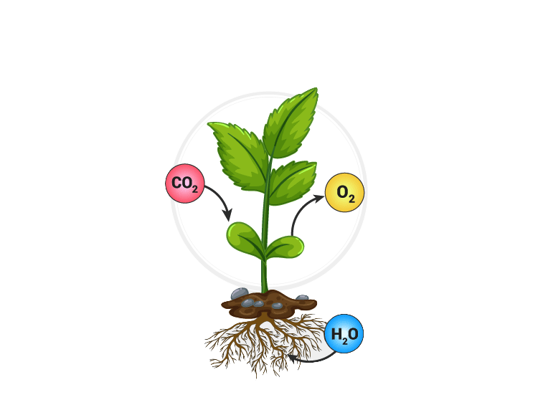
1) PRODUCERS : Roles of Organisms in Ecosystems
a producer in an ecosystem is an organism that makes its own food from non-living materials
  plants harness the energy of the sun through photosynthesis
  using the sun’s energy, they convert carbon dioxide from the air and water into energy they can use and oxygen, which they release the to air
IN
OUT

Slide 5
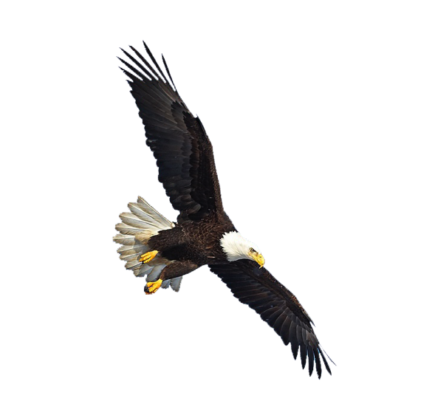
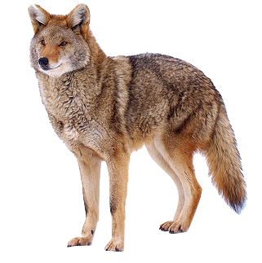
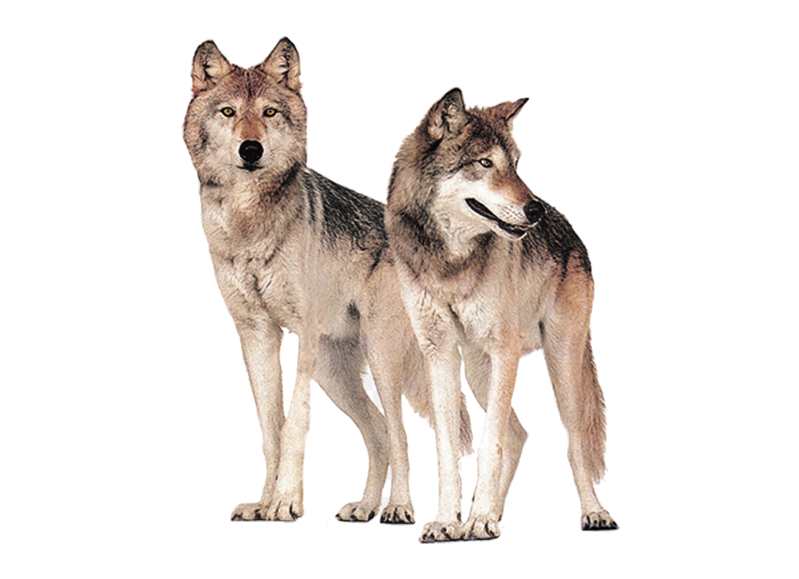
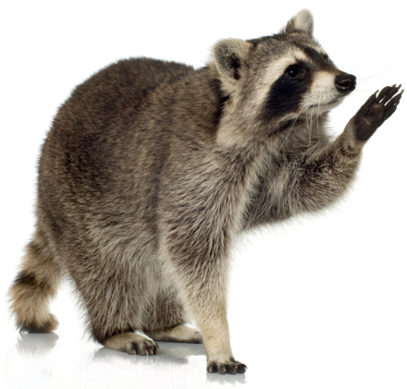
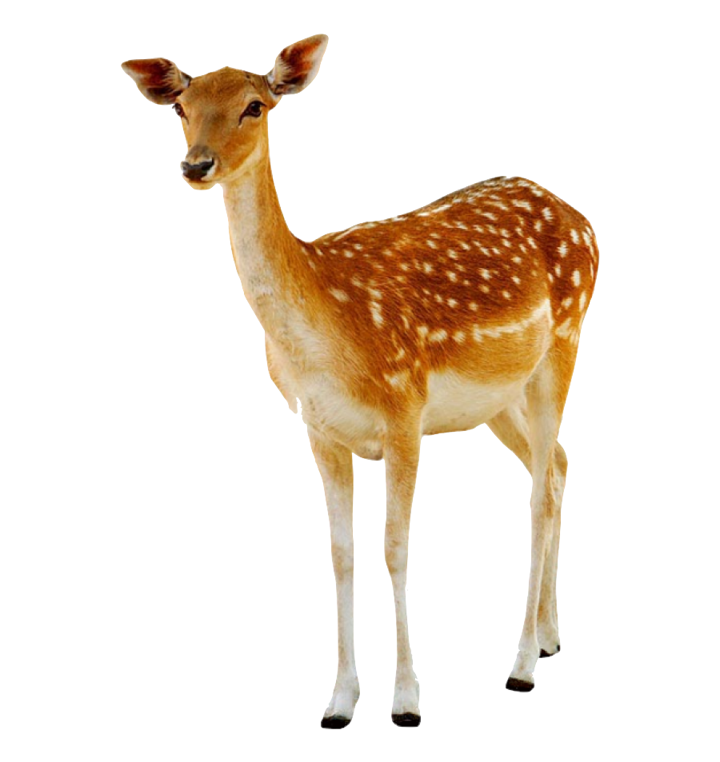

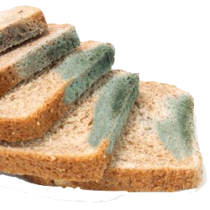
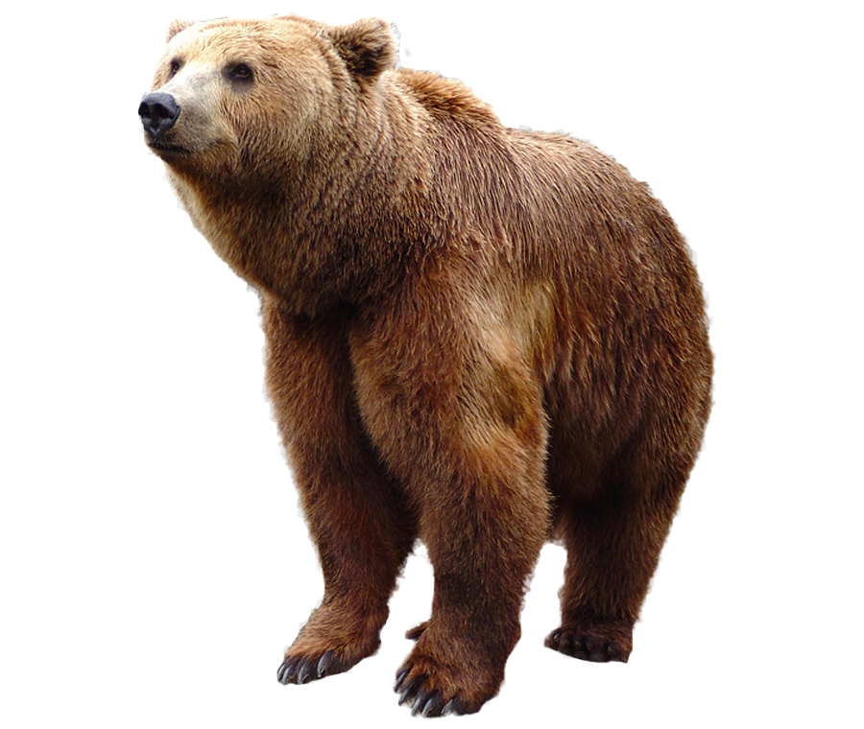
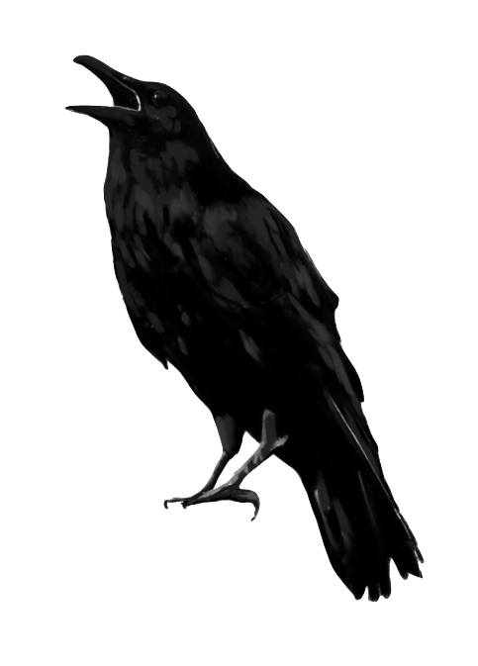

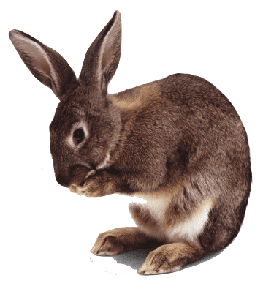
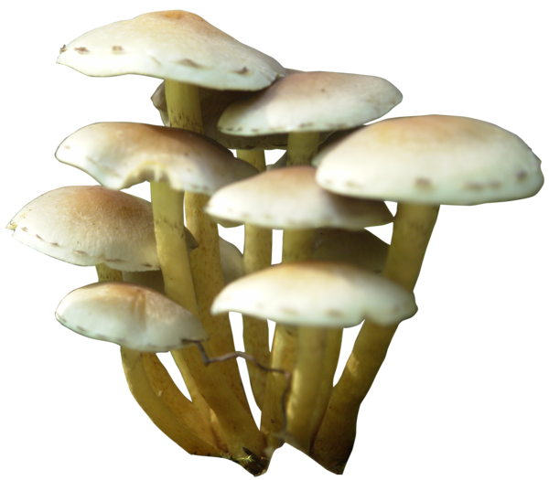
2) CONSUMERS : Roles of Organisms in Ecosystems
a consumer is an organism that eats other living things for energy
Herbivores
Carnivores
Omnivores
Scavengers
Decomposers and Detrivores
are organisms that eat only plants
organisms that eat only other animals
organisms that eat both plants and animals
organisms that eats animals that are already dead
organisms that break down dead organisms or waste into simpler substances
Notes:
o herbivores are organisms that eat only plants §▪ e.g. deer, rabbits
o carnivores are organisms that eat only other animals §▪ e.g. wolves, eagles
o omnivores are organisms that eat both plants and animals §▪ e.g. raccoons, bears
o scavengers are organisms that eats animals that are already dead §▪ e.g. coyotes, ravens
o decomposers and detrivores are organisms that dead organisms or waste into simpler substances §▪ e.g. bacteria, fungi, mold

Slide 6
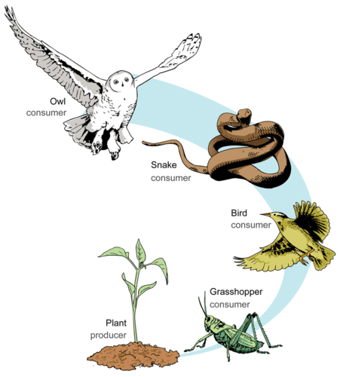

Roles of Organisms in Ecosystems
Fungus
Decomposer

Slide 7
Food Chains
& Food Webs

Slide 8

Food Chains & Food Webs
energy moves through ecosystems:
  from the producers
  up through the omnivores
  then to the carnivores

Slide 9
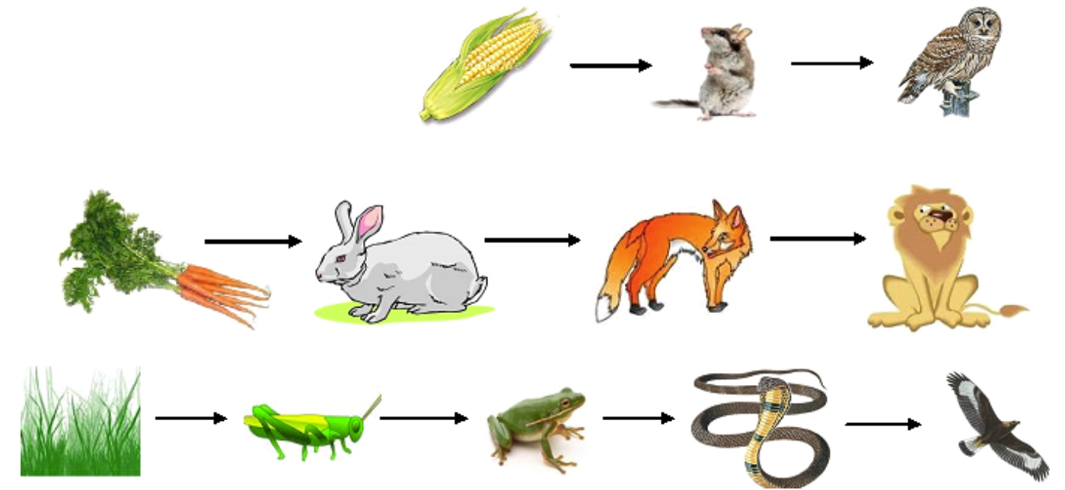
FOOD CHAINS
a food chain is a sequence that shows how energy and nutrients are transferred from one organism to another

Slide 10
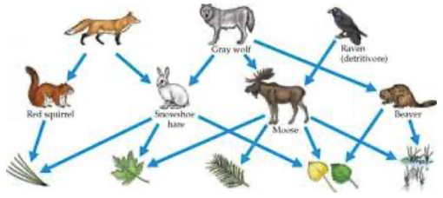
FOOD WEBS
a food web is a model that shows how the food chains in an ecosystem are interconnected

