Slide 1
PLANT &
ANIMAL CELLS
UNDERSTANDING LIFE SYSTEMS CELLS

Slide 2
UNDERSTANDING LIFE SYSTEMS CELLS
3.3 compare the structure and function of plant and animal cells

Slide 3
UNDERSTANDING LIFE SYSTEMS CELLS
3.2 identify structures and organelles in cells,
including the nucleus, cell membrane, cell wall, chloroplasts, vacuole, mitochondria, and cytoplasm, and explain the basic functions of each

Slide 4
all living things are made up of cells
cells contain ORGANELLES
(small structures that each have
a specific function)

Slide 5
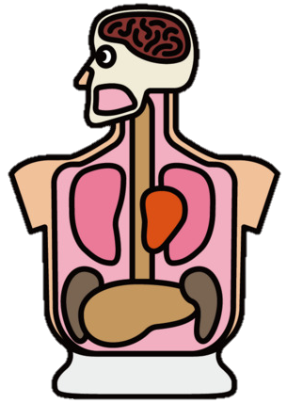
Organelles
are similar
to organs in the
human body

Slide 6
ORGANELLES
IN ANIMAL & PLANT CELLS

Slide 7

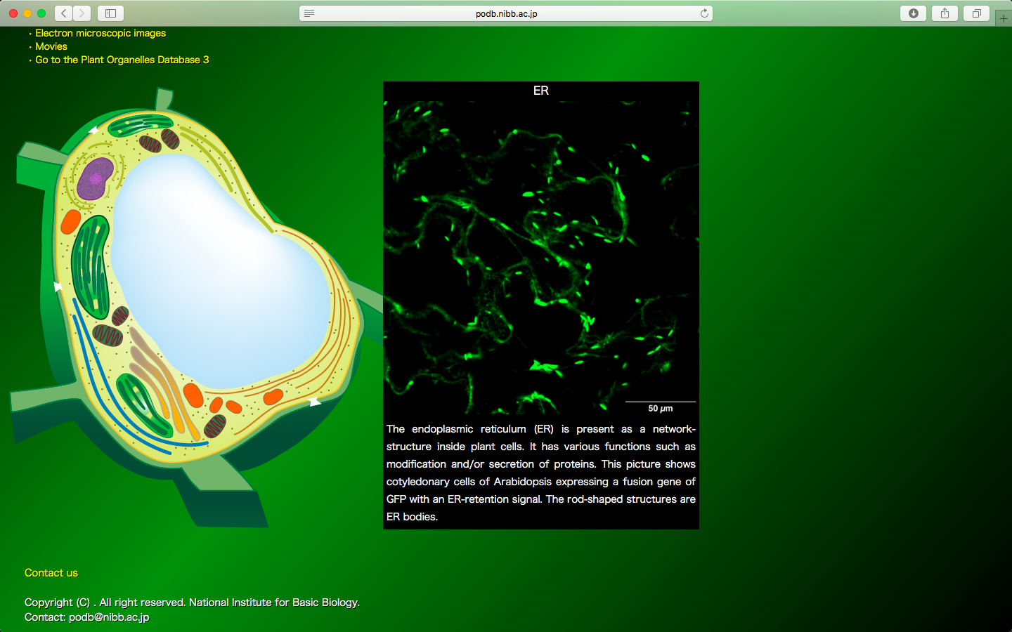
ORGANELLES
IN ANIMAL & PLANT CELLS
Use the website to
label the diagram
bit.ly/plantorganelles
Golgi Body
Endoplasmic
Reticulum
Cell Membrane
Cytoplasm
Vacuole
Nucleus
Mitochondria
Ribosome

Slide 8
CELL MEMBRANE
CYTOPLASM
ENDOPLASMIC RETICULUM
NUCLEUS
CHLOROPLAST
(Plants Only)
VACUOLE
MITOCHONDRIA
CELL WALL
(Plants only)
GOLGI BODY
INTERACT WITH THIS IMAGE - bit.ly/plantorganelles

Slide 9
ANIMAL CELL
PLANT CELL

