Slide 3
I have added my picture into my PowerPoint workspace
I have added 2 PNG image files to my picture
I have used ‘Removed Background’ tool to make the classroom background of my picture disappear
I have replaced my background with another digital picture
I have successfully printed my art

Slide 4
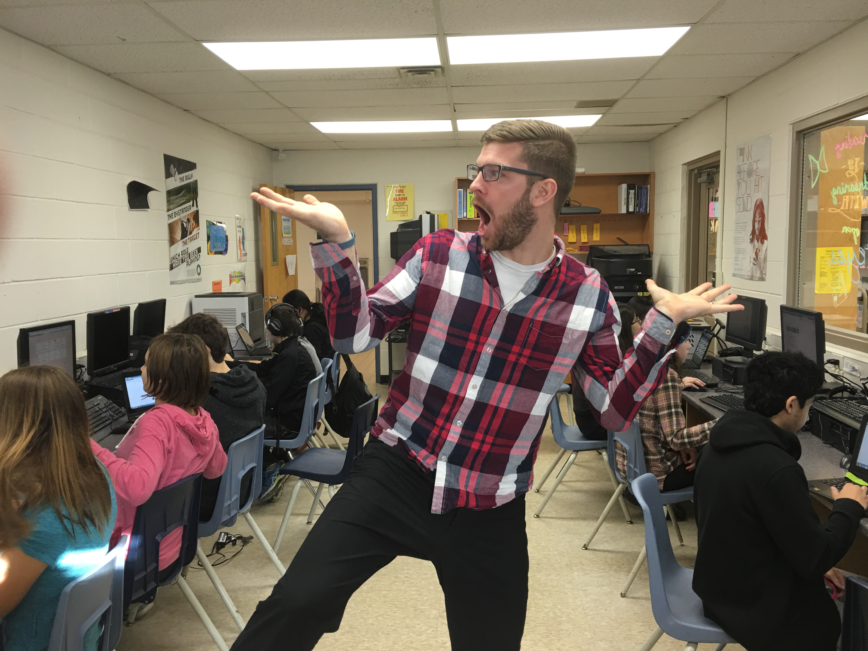

Slide 5
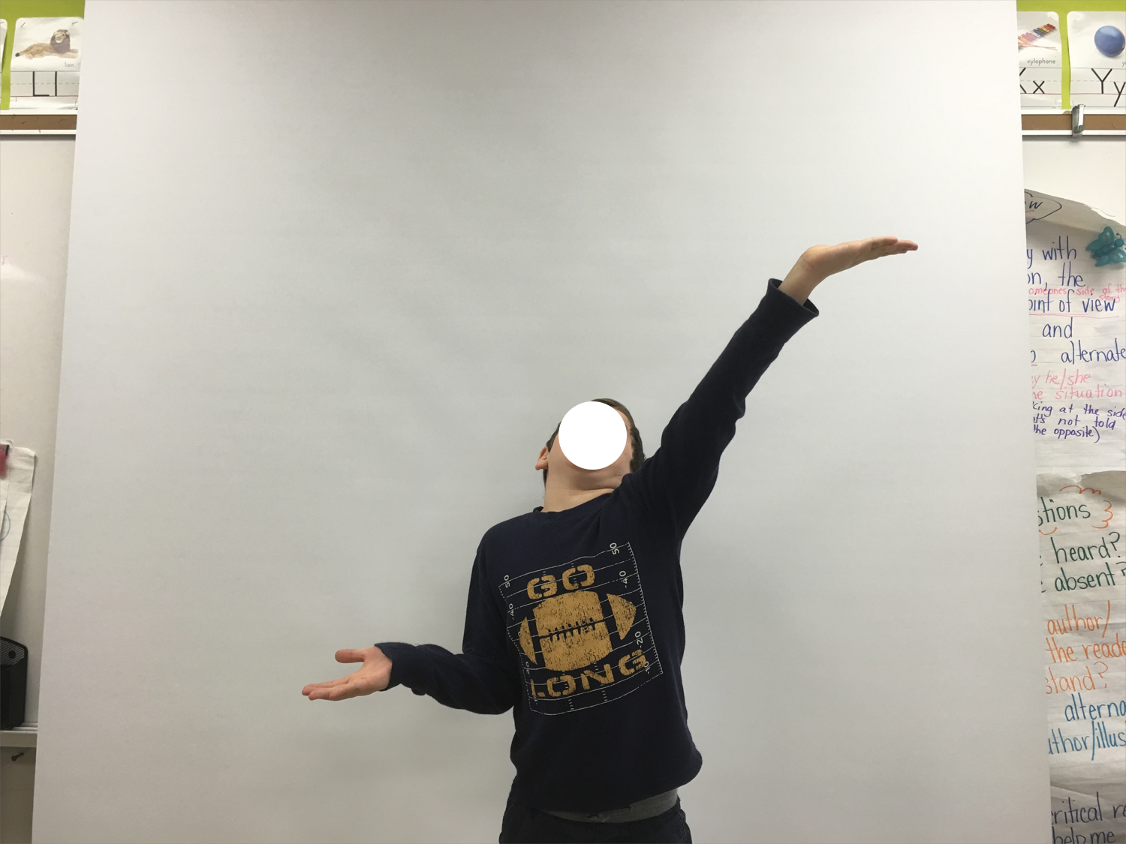

Slide 6
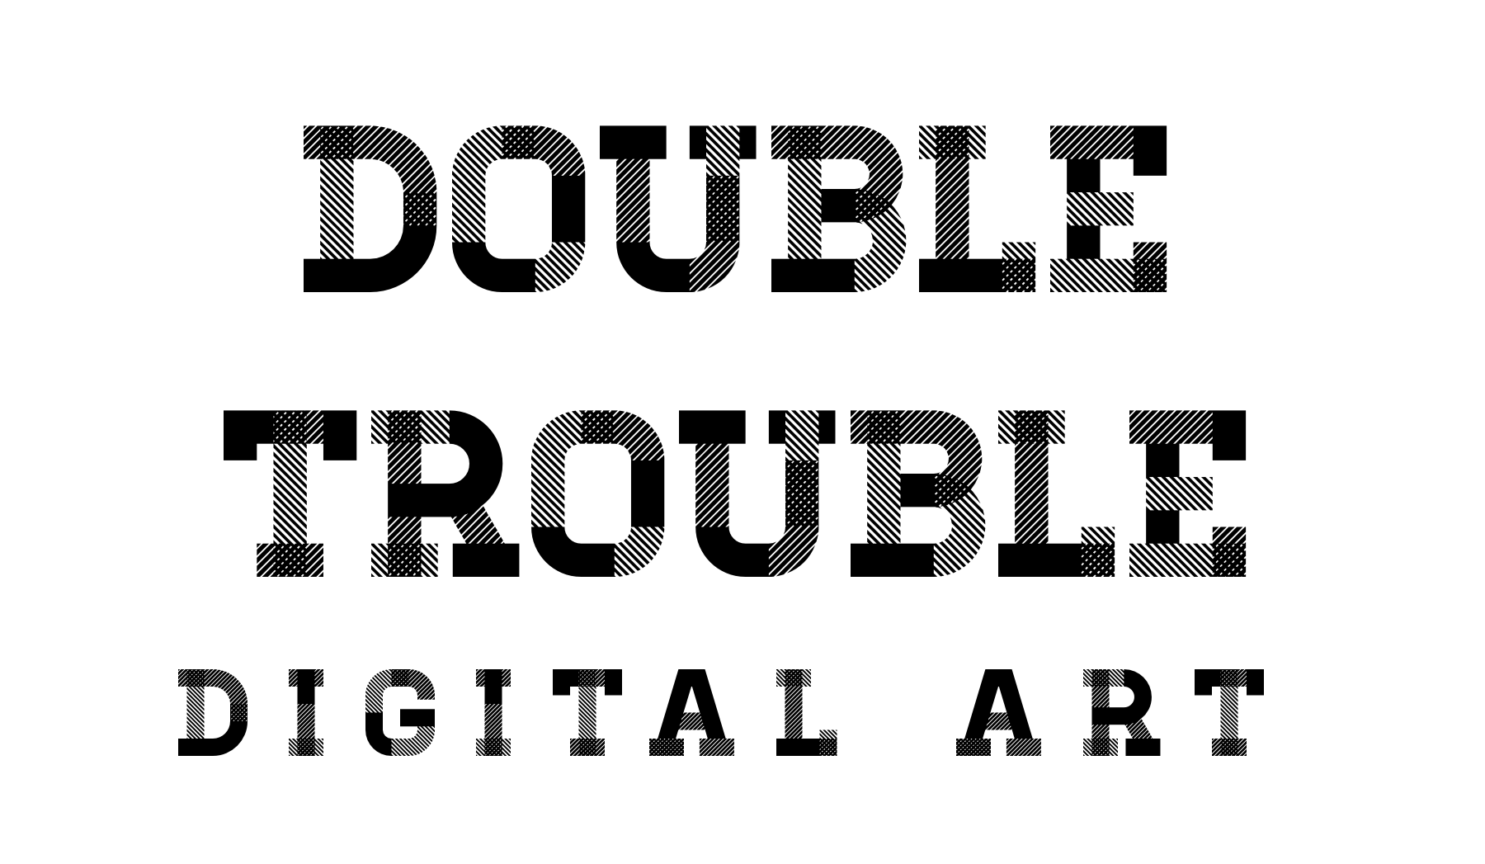

Slide 7
I have taken 2 pictures of myself on opposite sides of the camera
I have added my 2 pictures into my PowerPoint workspace
I have cropped (or ‘Removed Background’) on my top photo
My 2 photos line up so that it looks like 1 photo
I have successfully printed my art

Slide 8
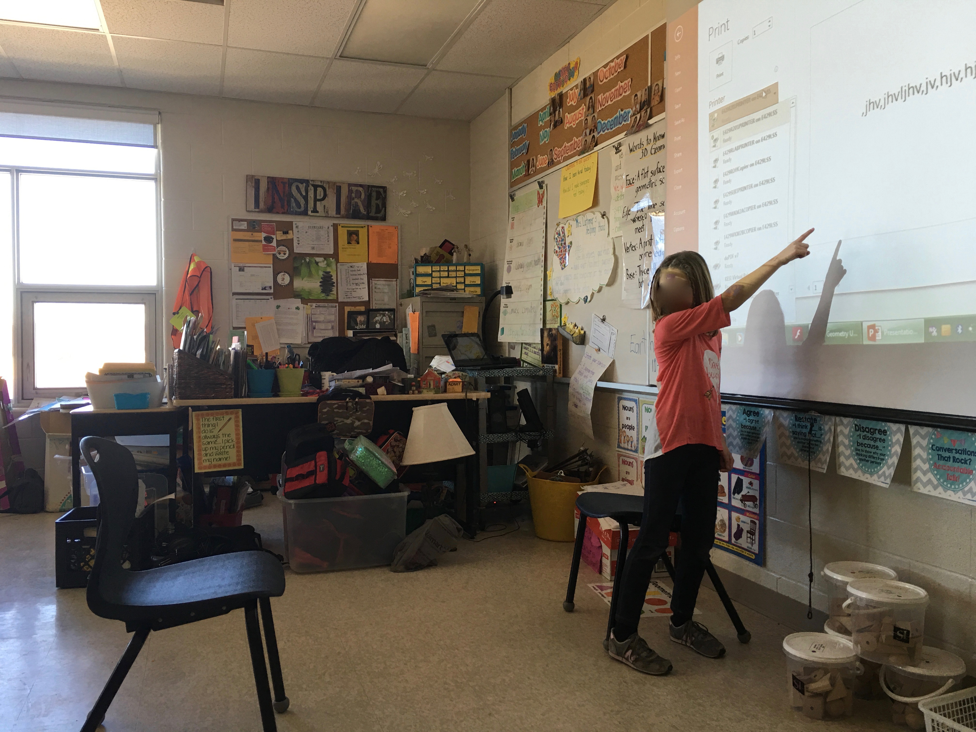
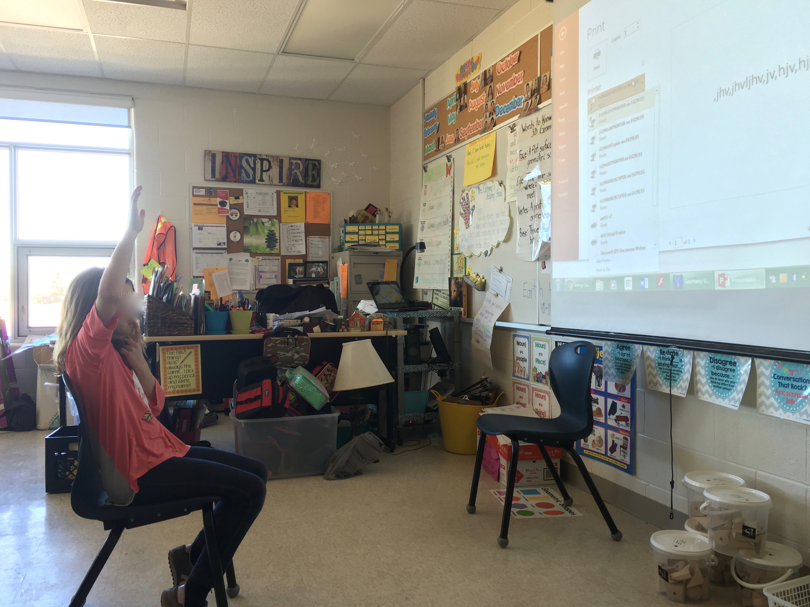

Slide 9
