Slide 1
Double Trouble Digital Art

Slide 2
I will be successful when:
Double trouble Art
I have taken 2 pictures of myself on opposite sides of the camera
I have added my 2 pictures into my PowerPoint workspace
I have cropped (or ‘Removed Background’) on my top photo
My 2 photos line up so that it looks like 1 photo
I have successfully printed my art

Slide 3
Take 2 pictures without moving the camera. Only move the student to the other half of the picture.

Slide 4
1
2

Slide 5
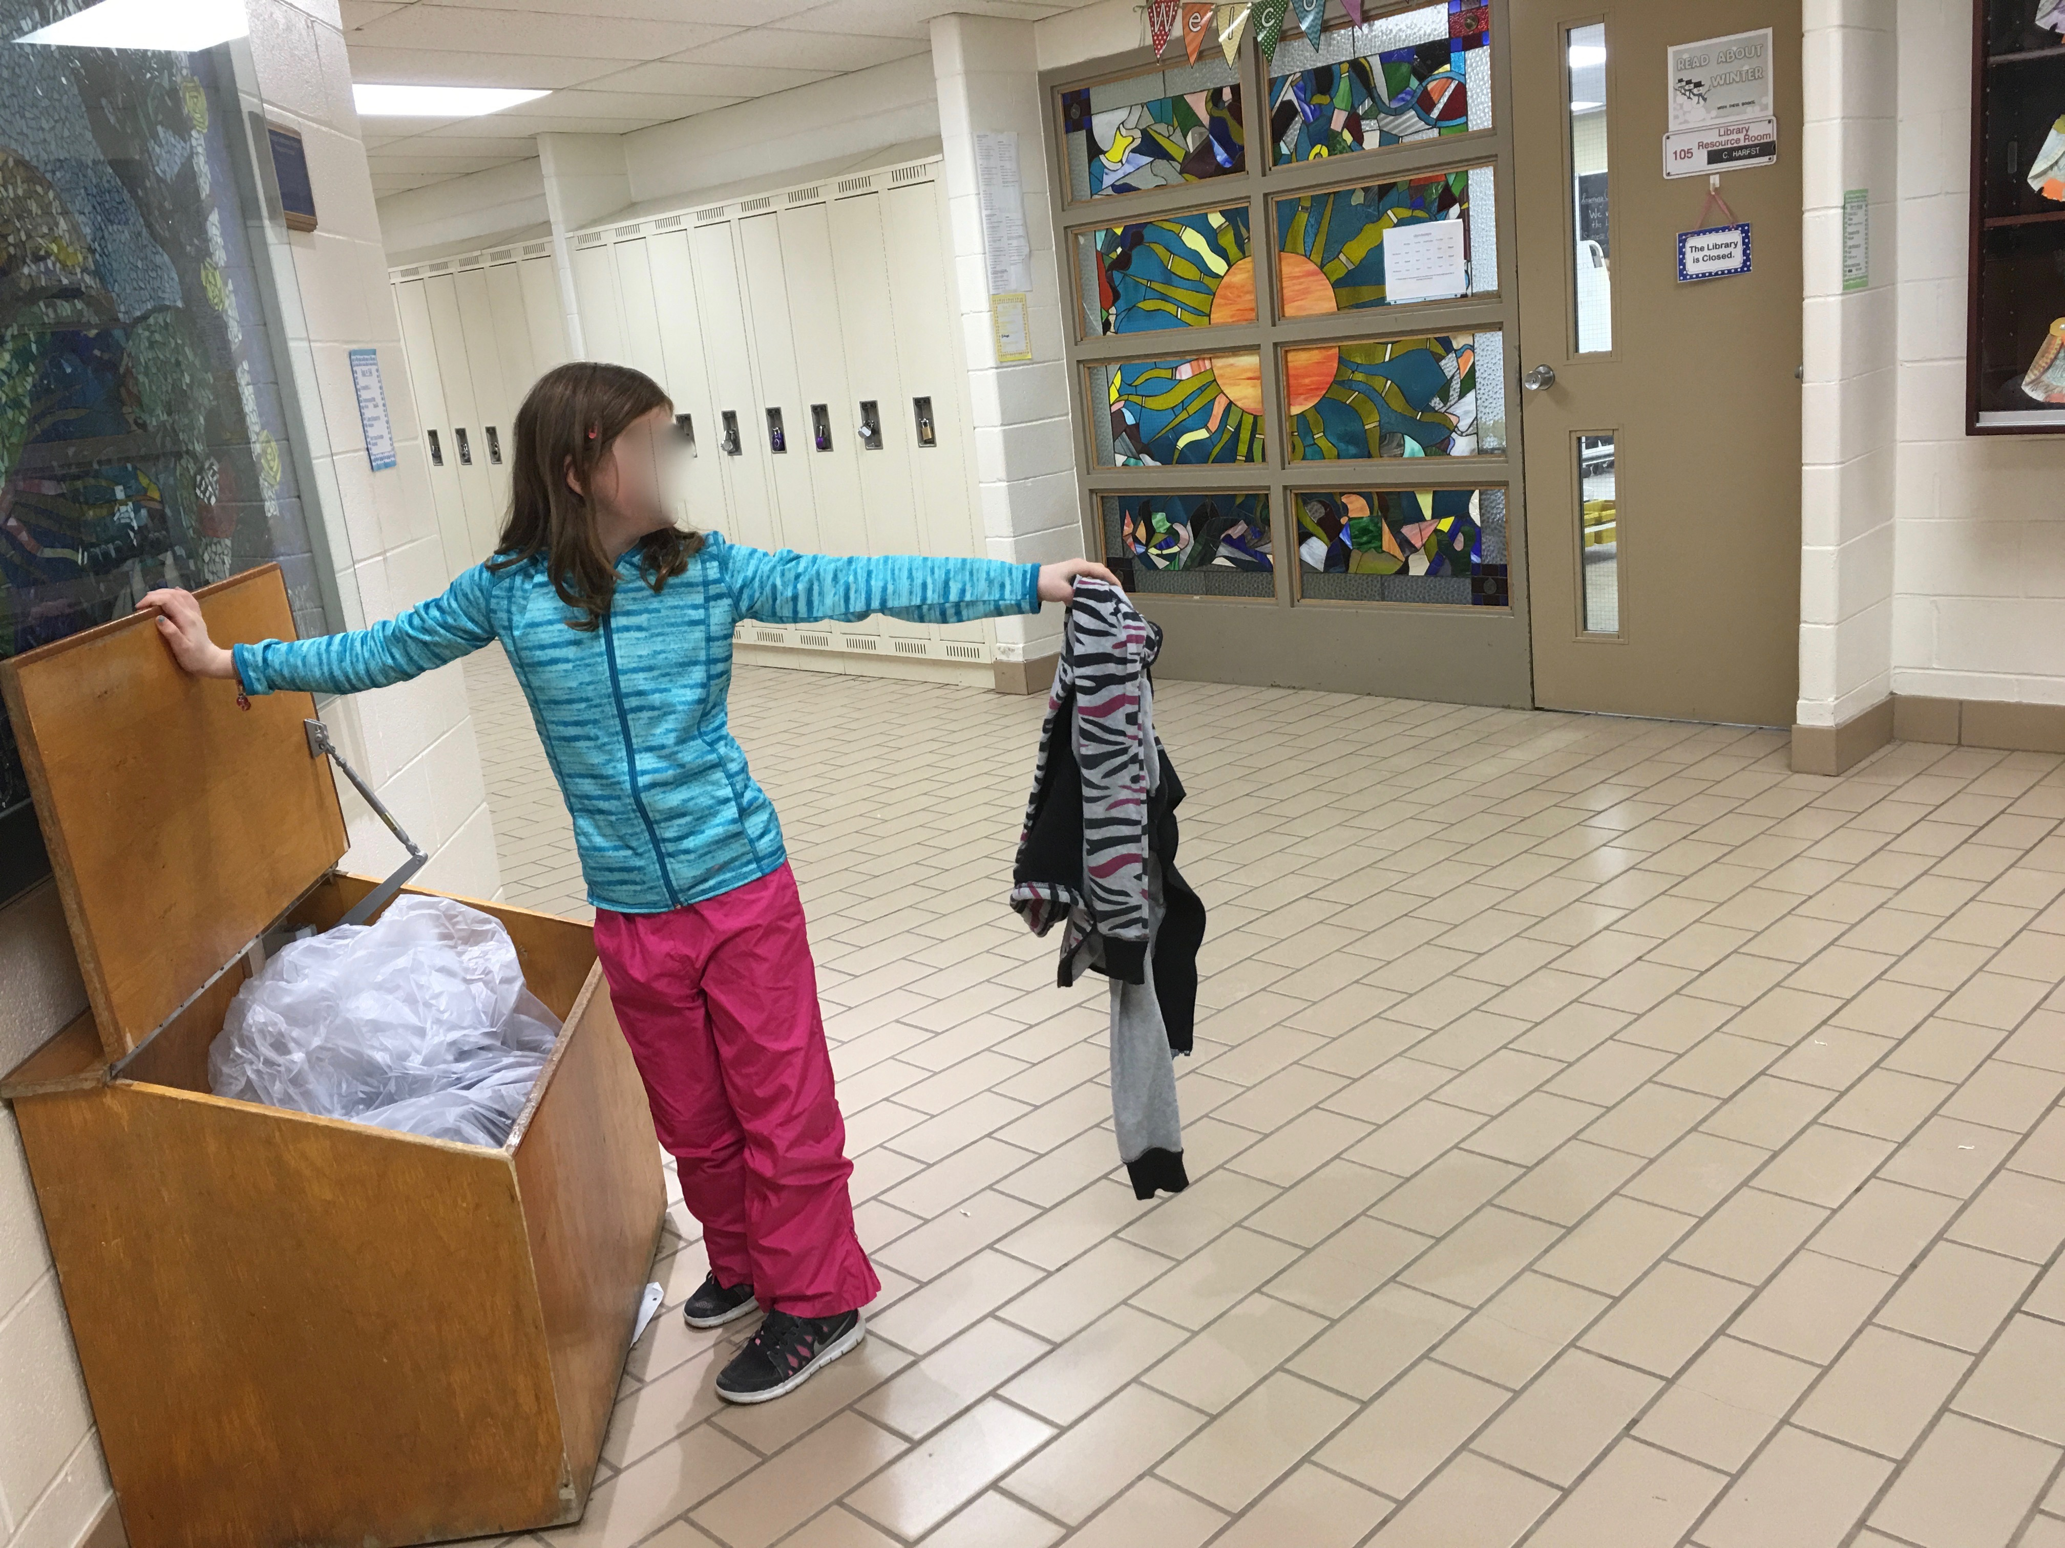
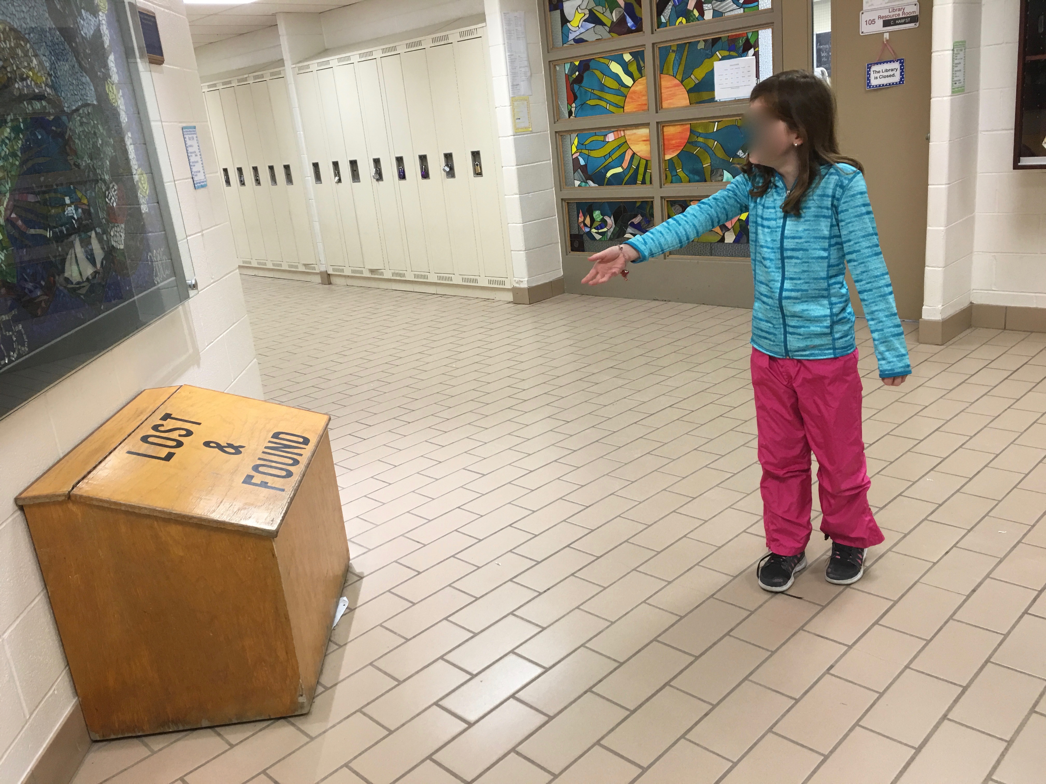
1
2

Slide 7
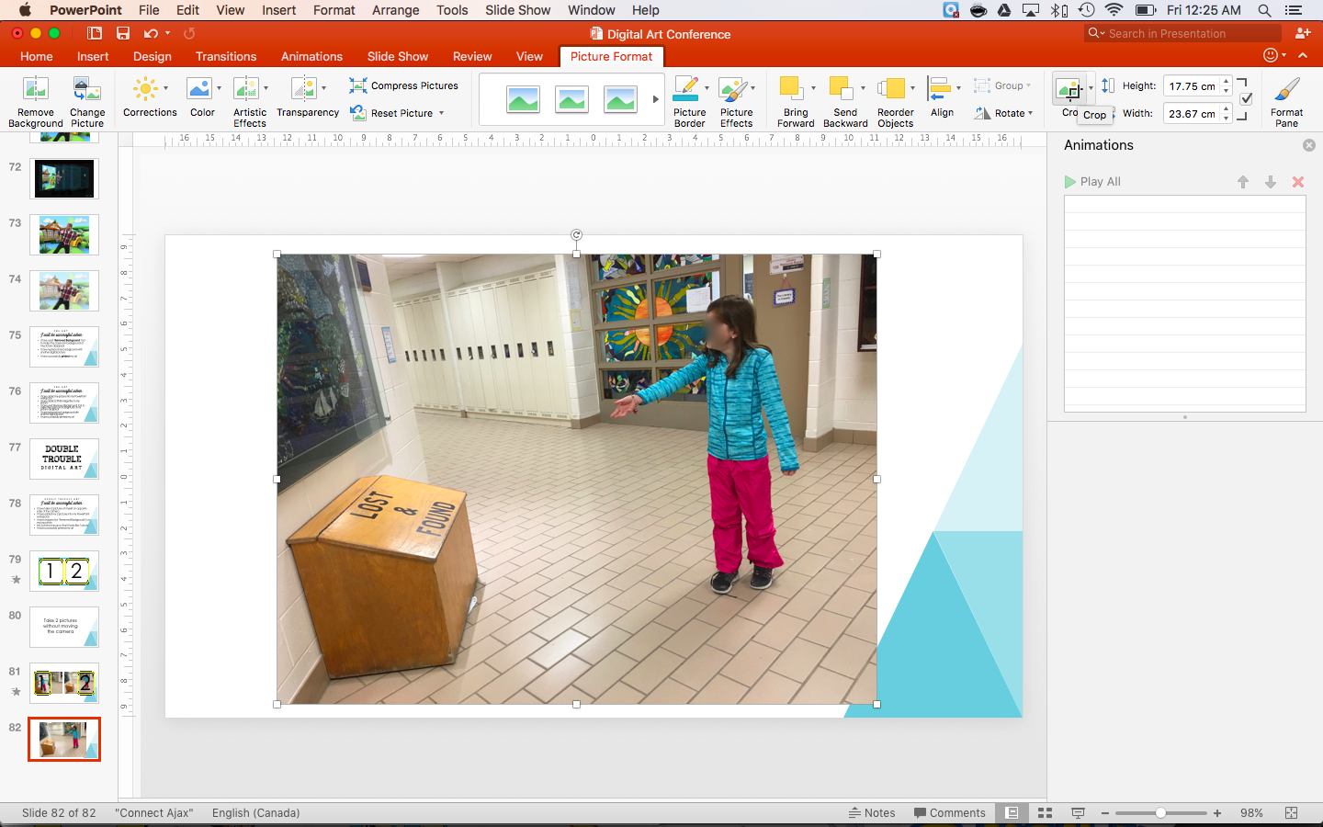

Slide 9
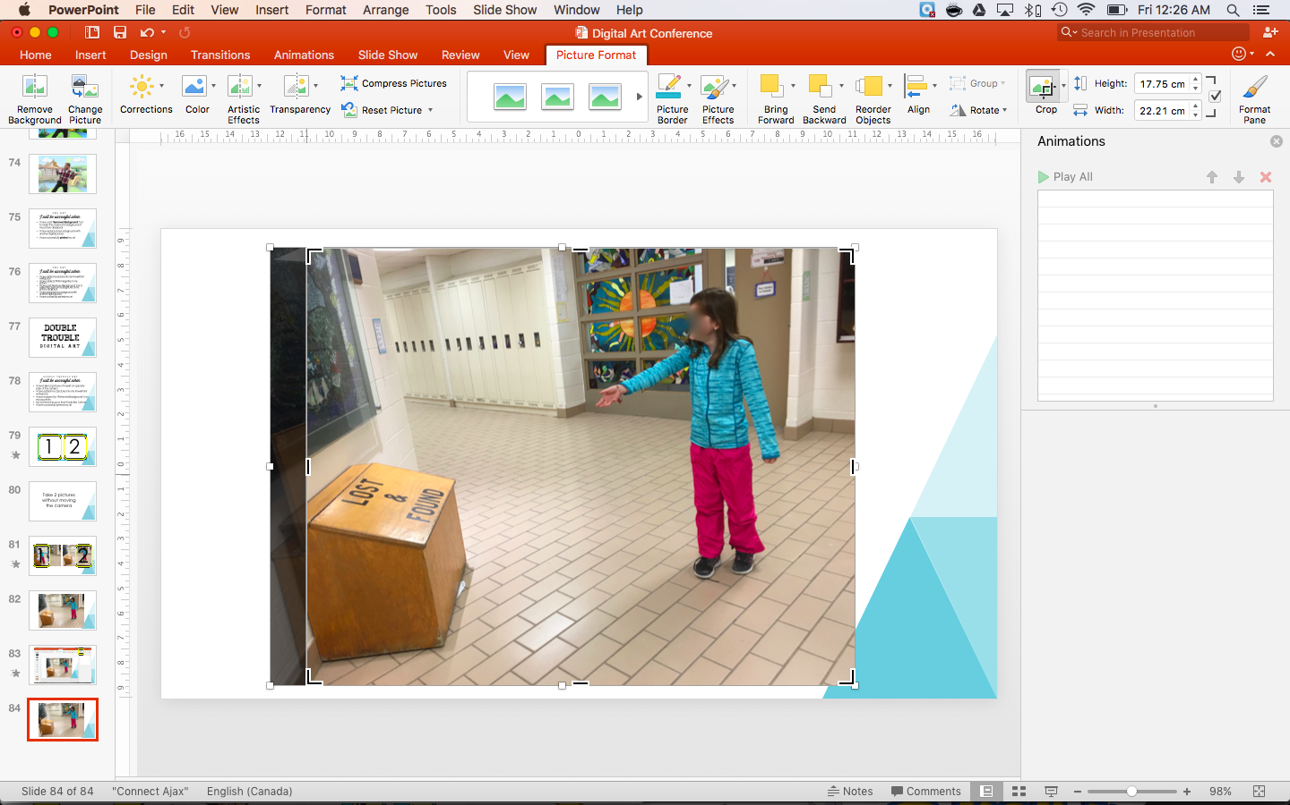
STRETCH
CROP

Slide 10
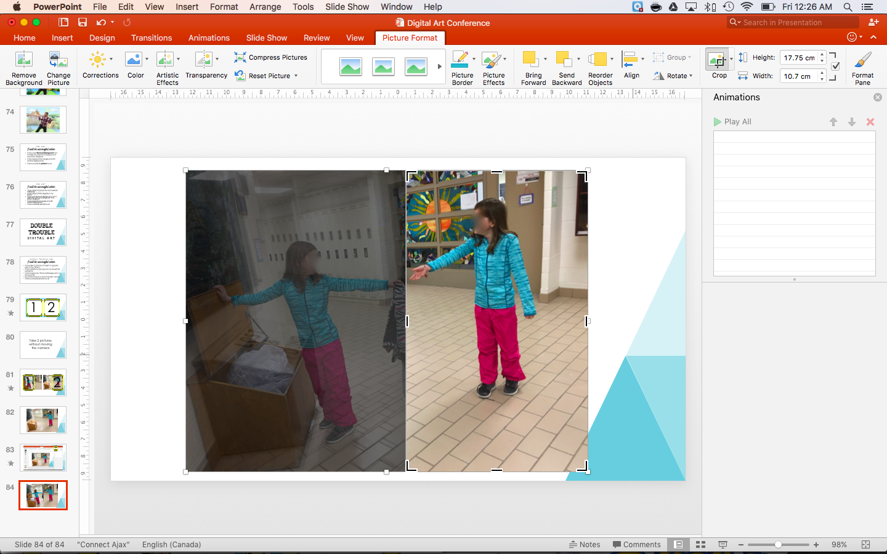

Slide 11
When you cross the midline

Slide 12
2 Options
REMOVE BACKGROUND
CROP TO SHAPE

Slide 17
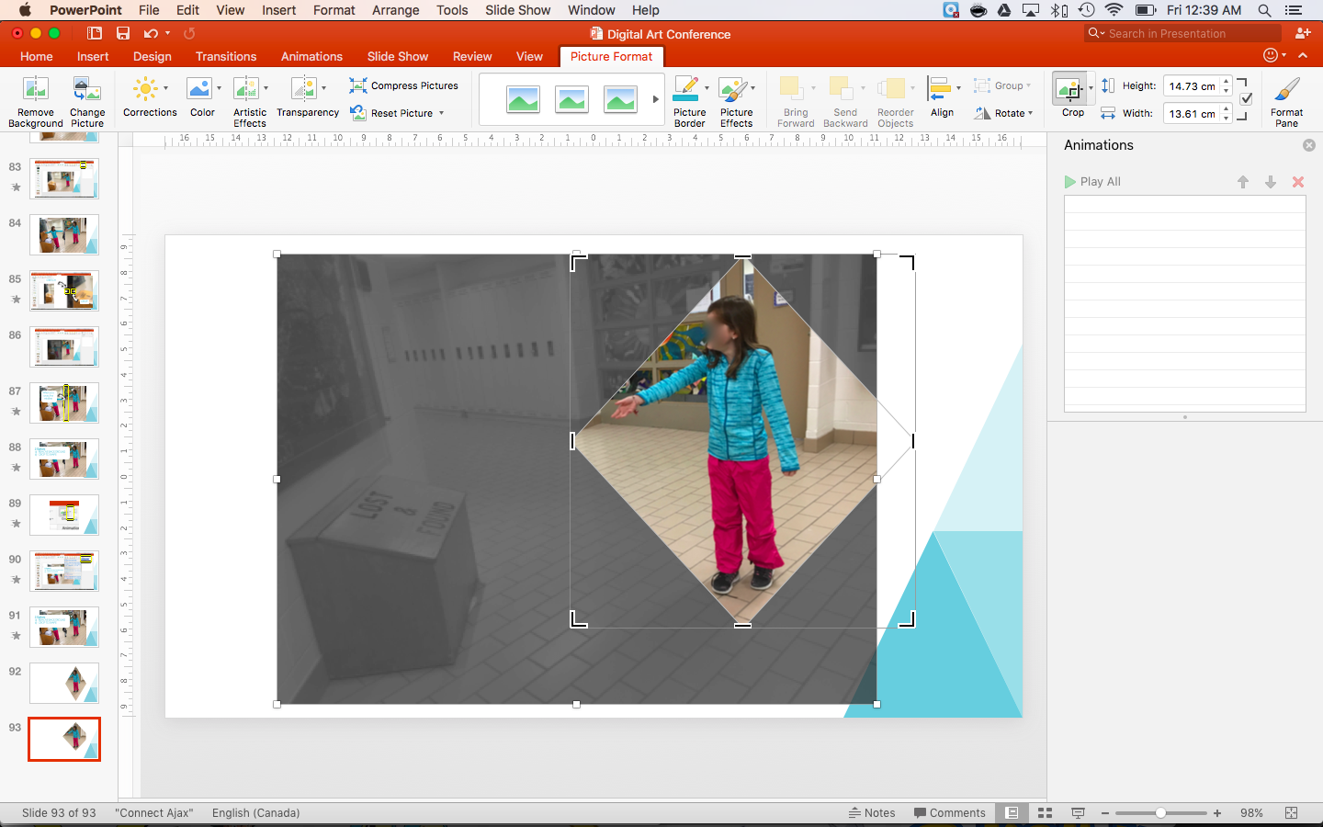

Slide 20
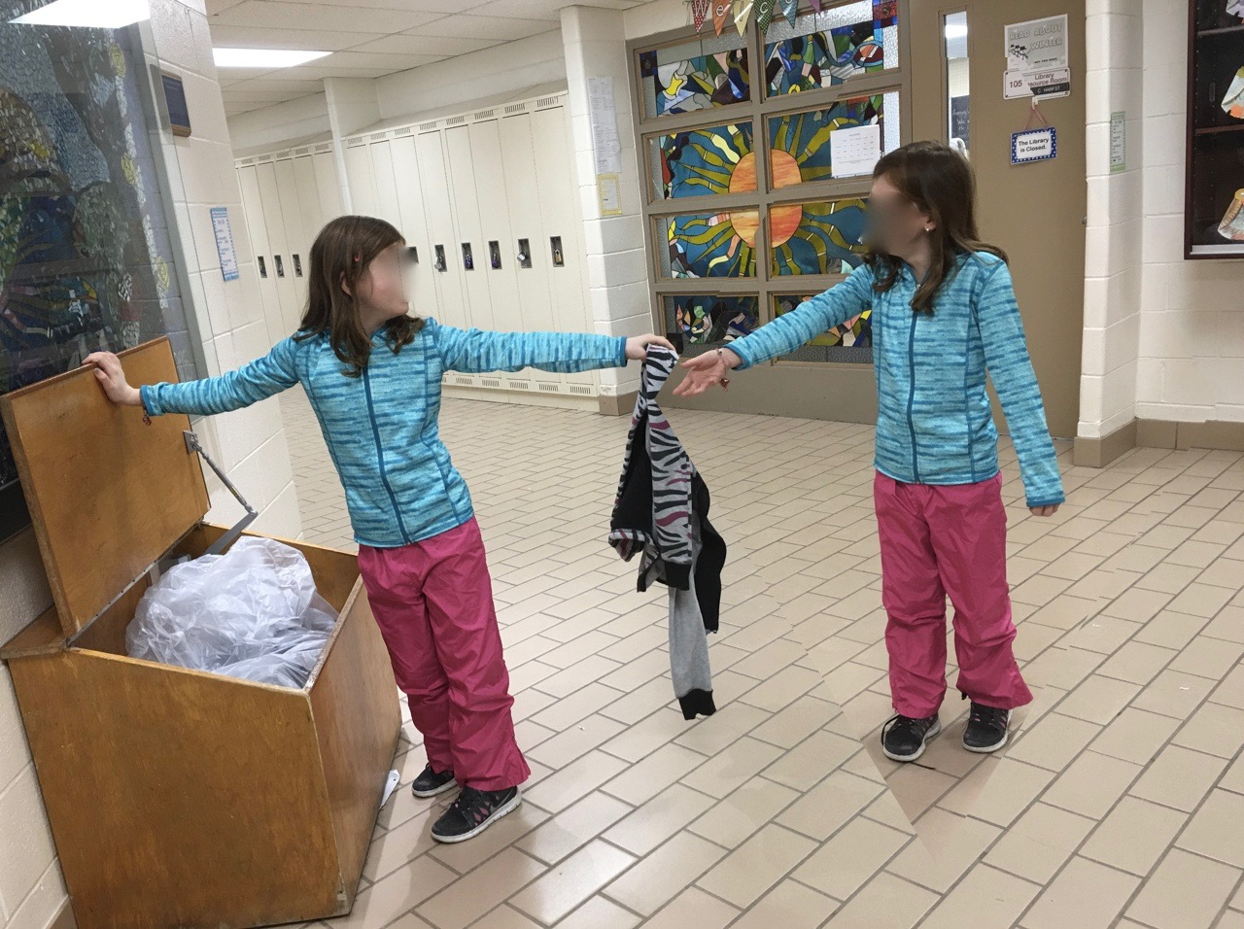

Slide 21
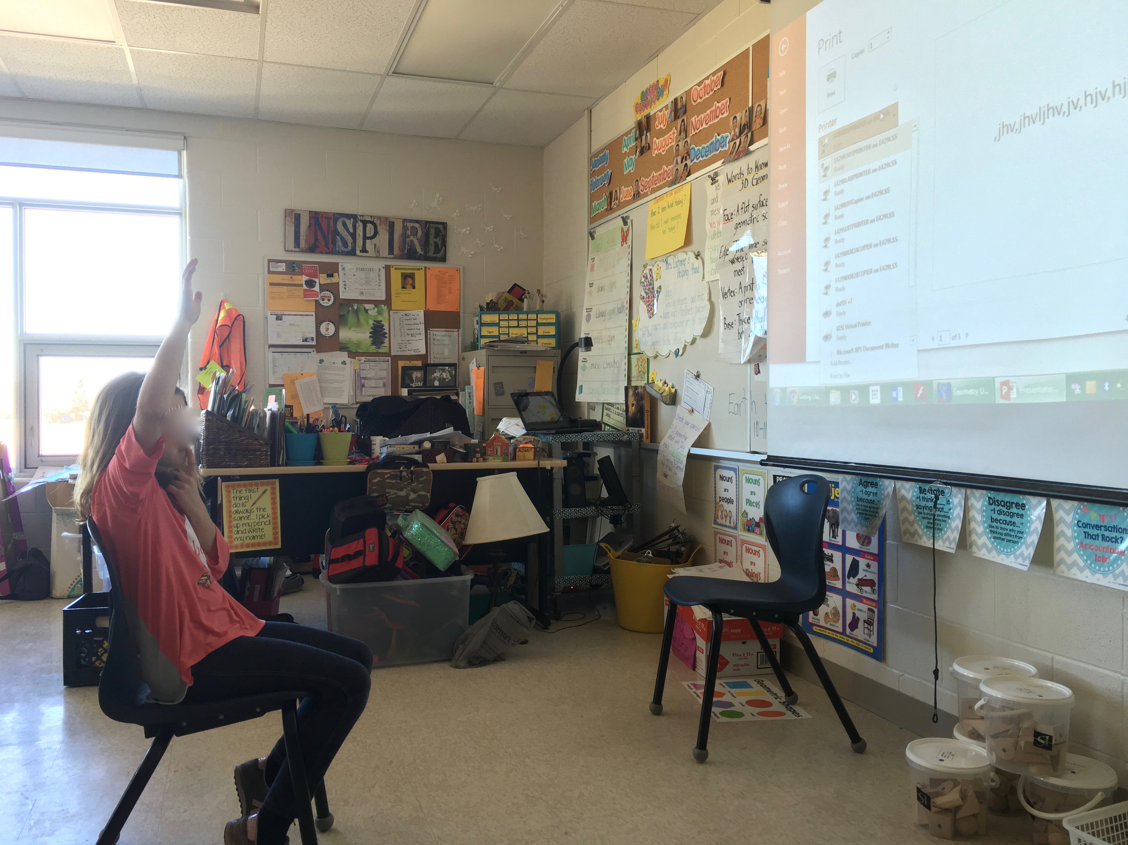
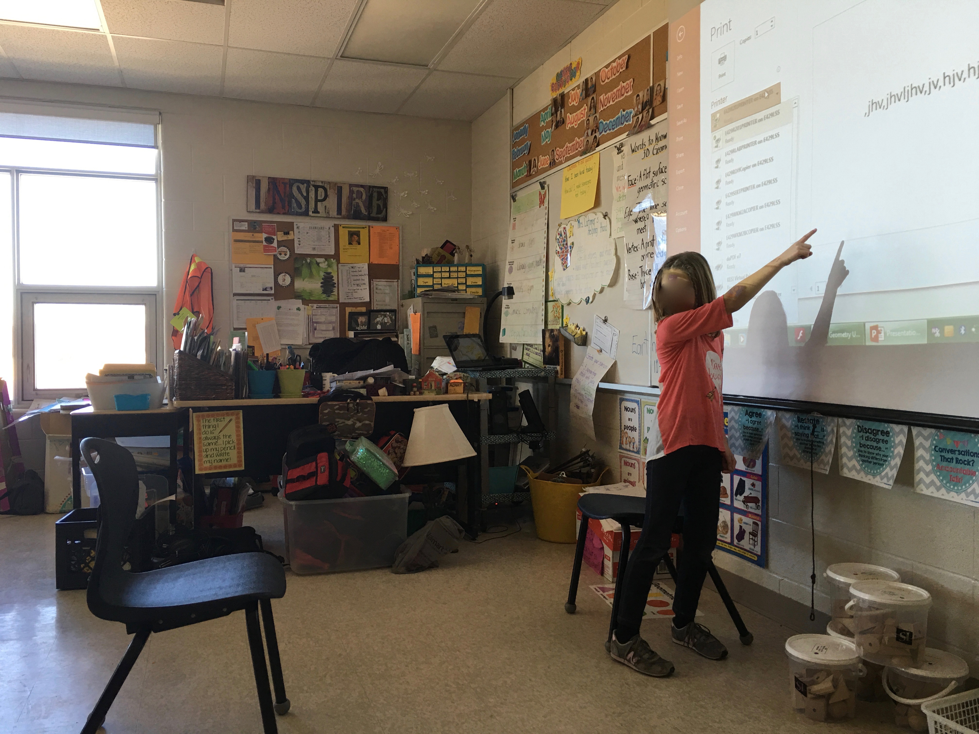

Slide 22
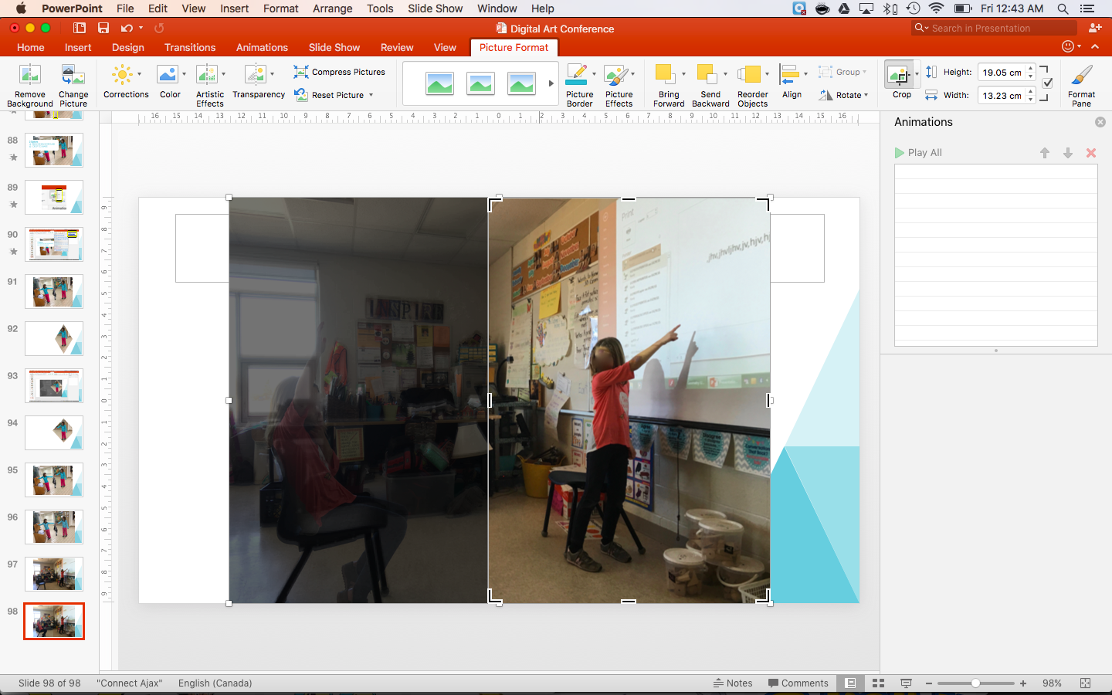

Slide 24
I will be successful when:
Double trouble Art
I have taken 2 pictures of myself on opposite sides of the camera
I have added my 2 pictures into my PowerPoint workspace
I have cropped (or ‘Removed Background’) my top photo
My 2 photos line up so that it looks like 1 photo
I have successfully printed my art

