Slide 1
LESSON TWO

Slide 2
I will be successful when:
PNG Art
I have used ‘Removed Background’ tool to make the classroom background of my picture disappear
I have replaced my background with another digital picture
I have successfully printed my art

Slide 3
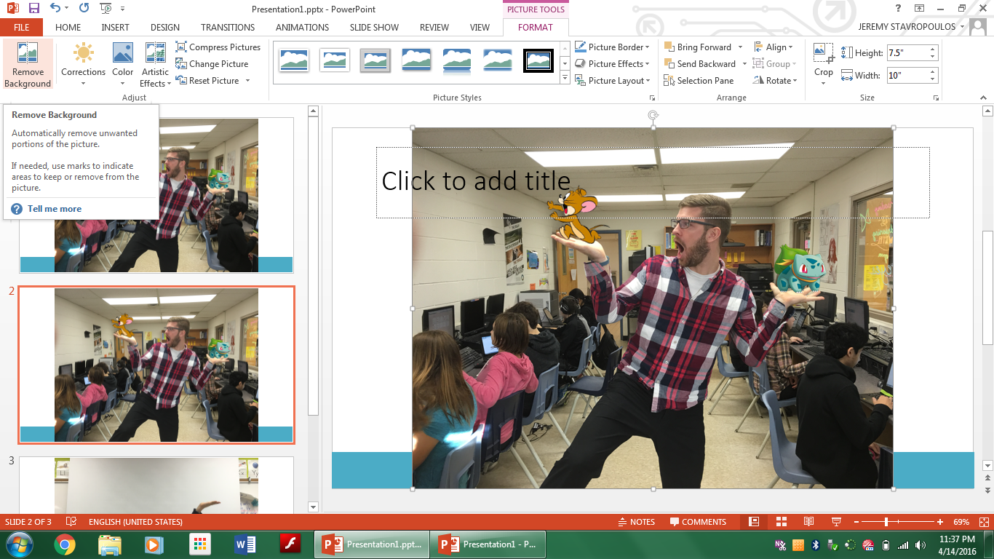

Slide 5
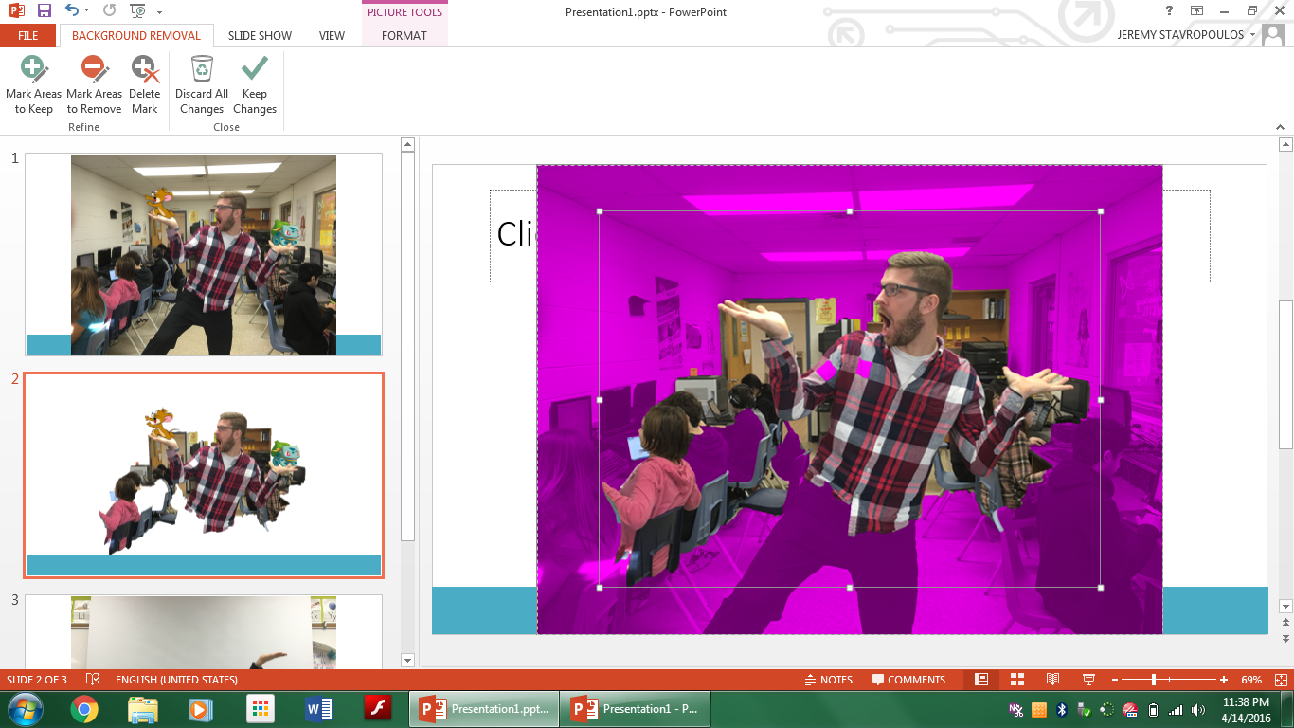

Slide 7
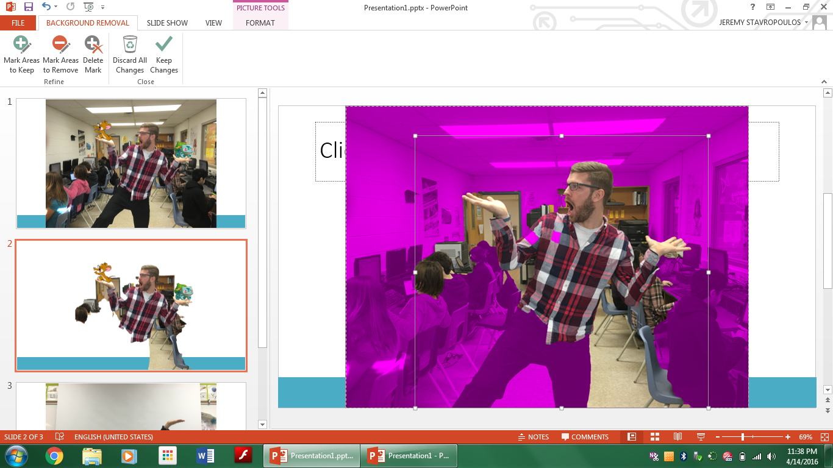

Slide 8
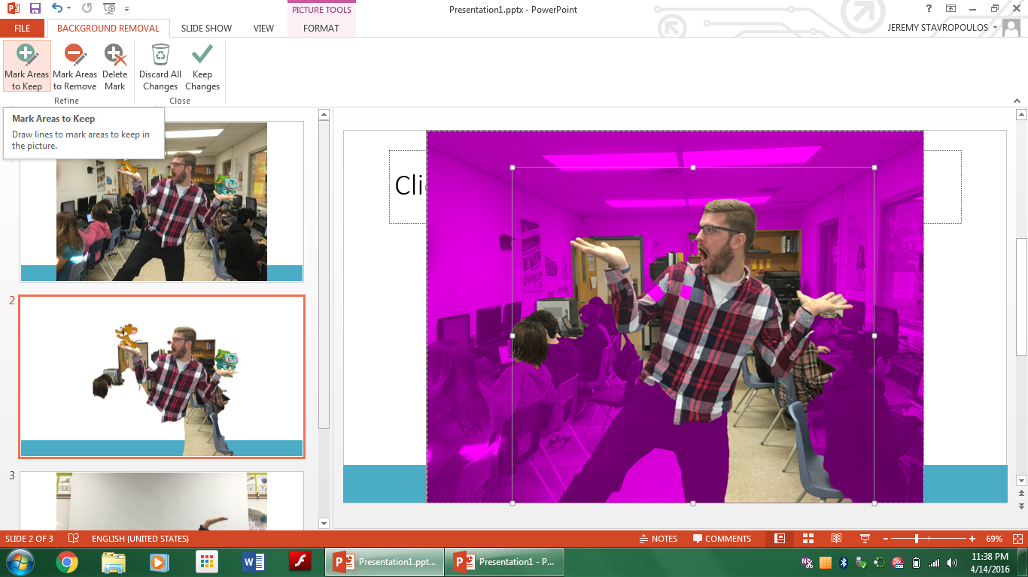

Slide 9
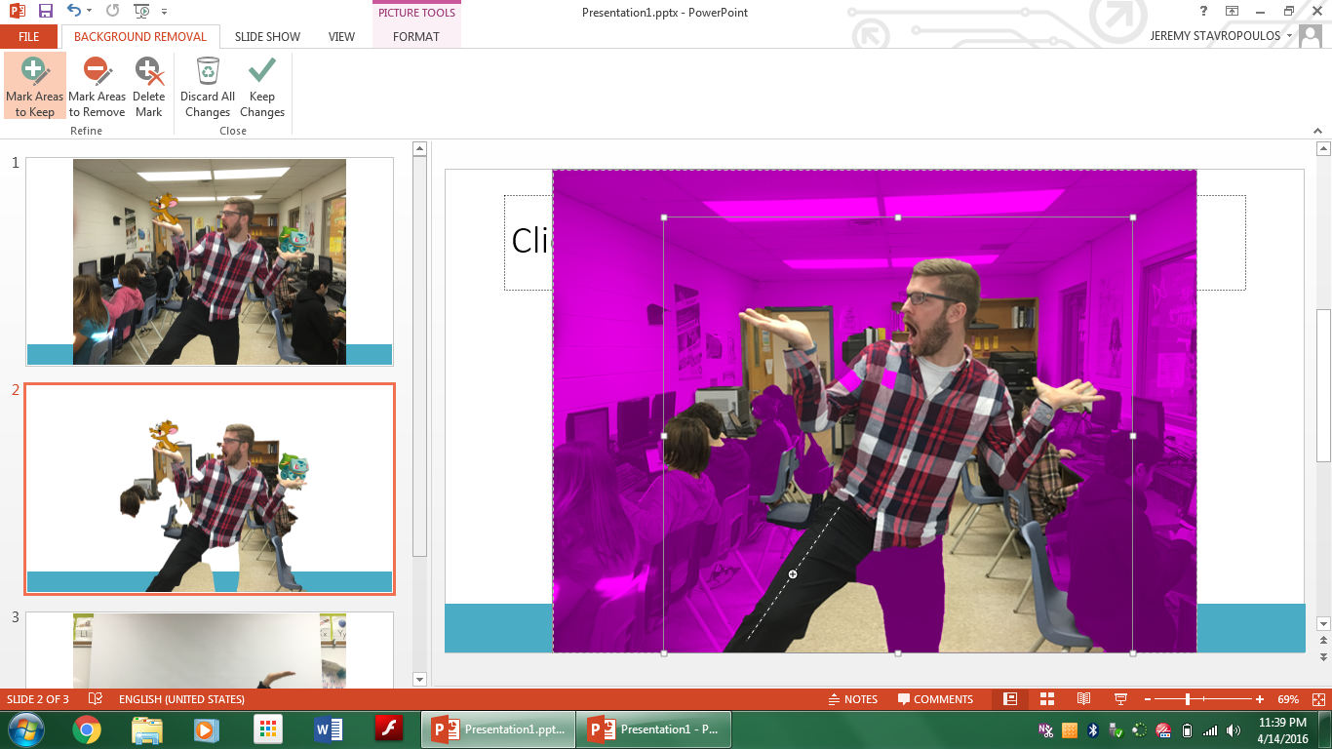

Slide 10
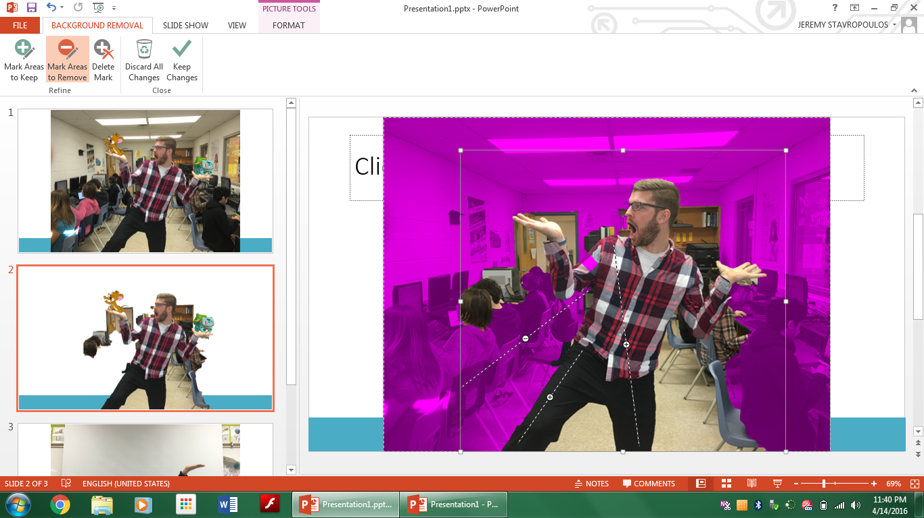

Slide 11
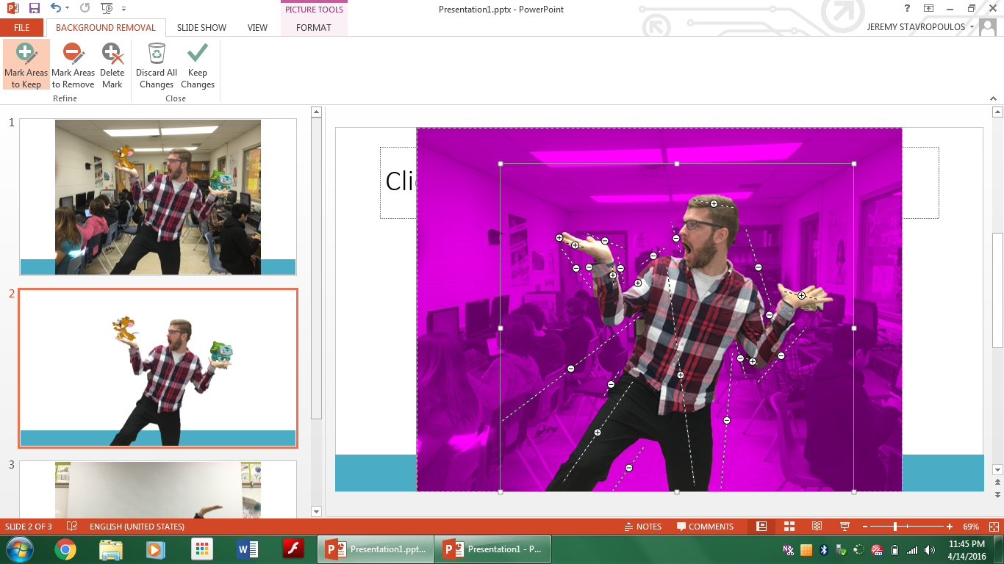

Slide 13
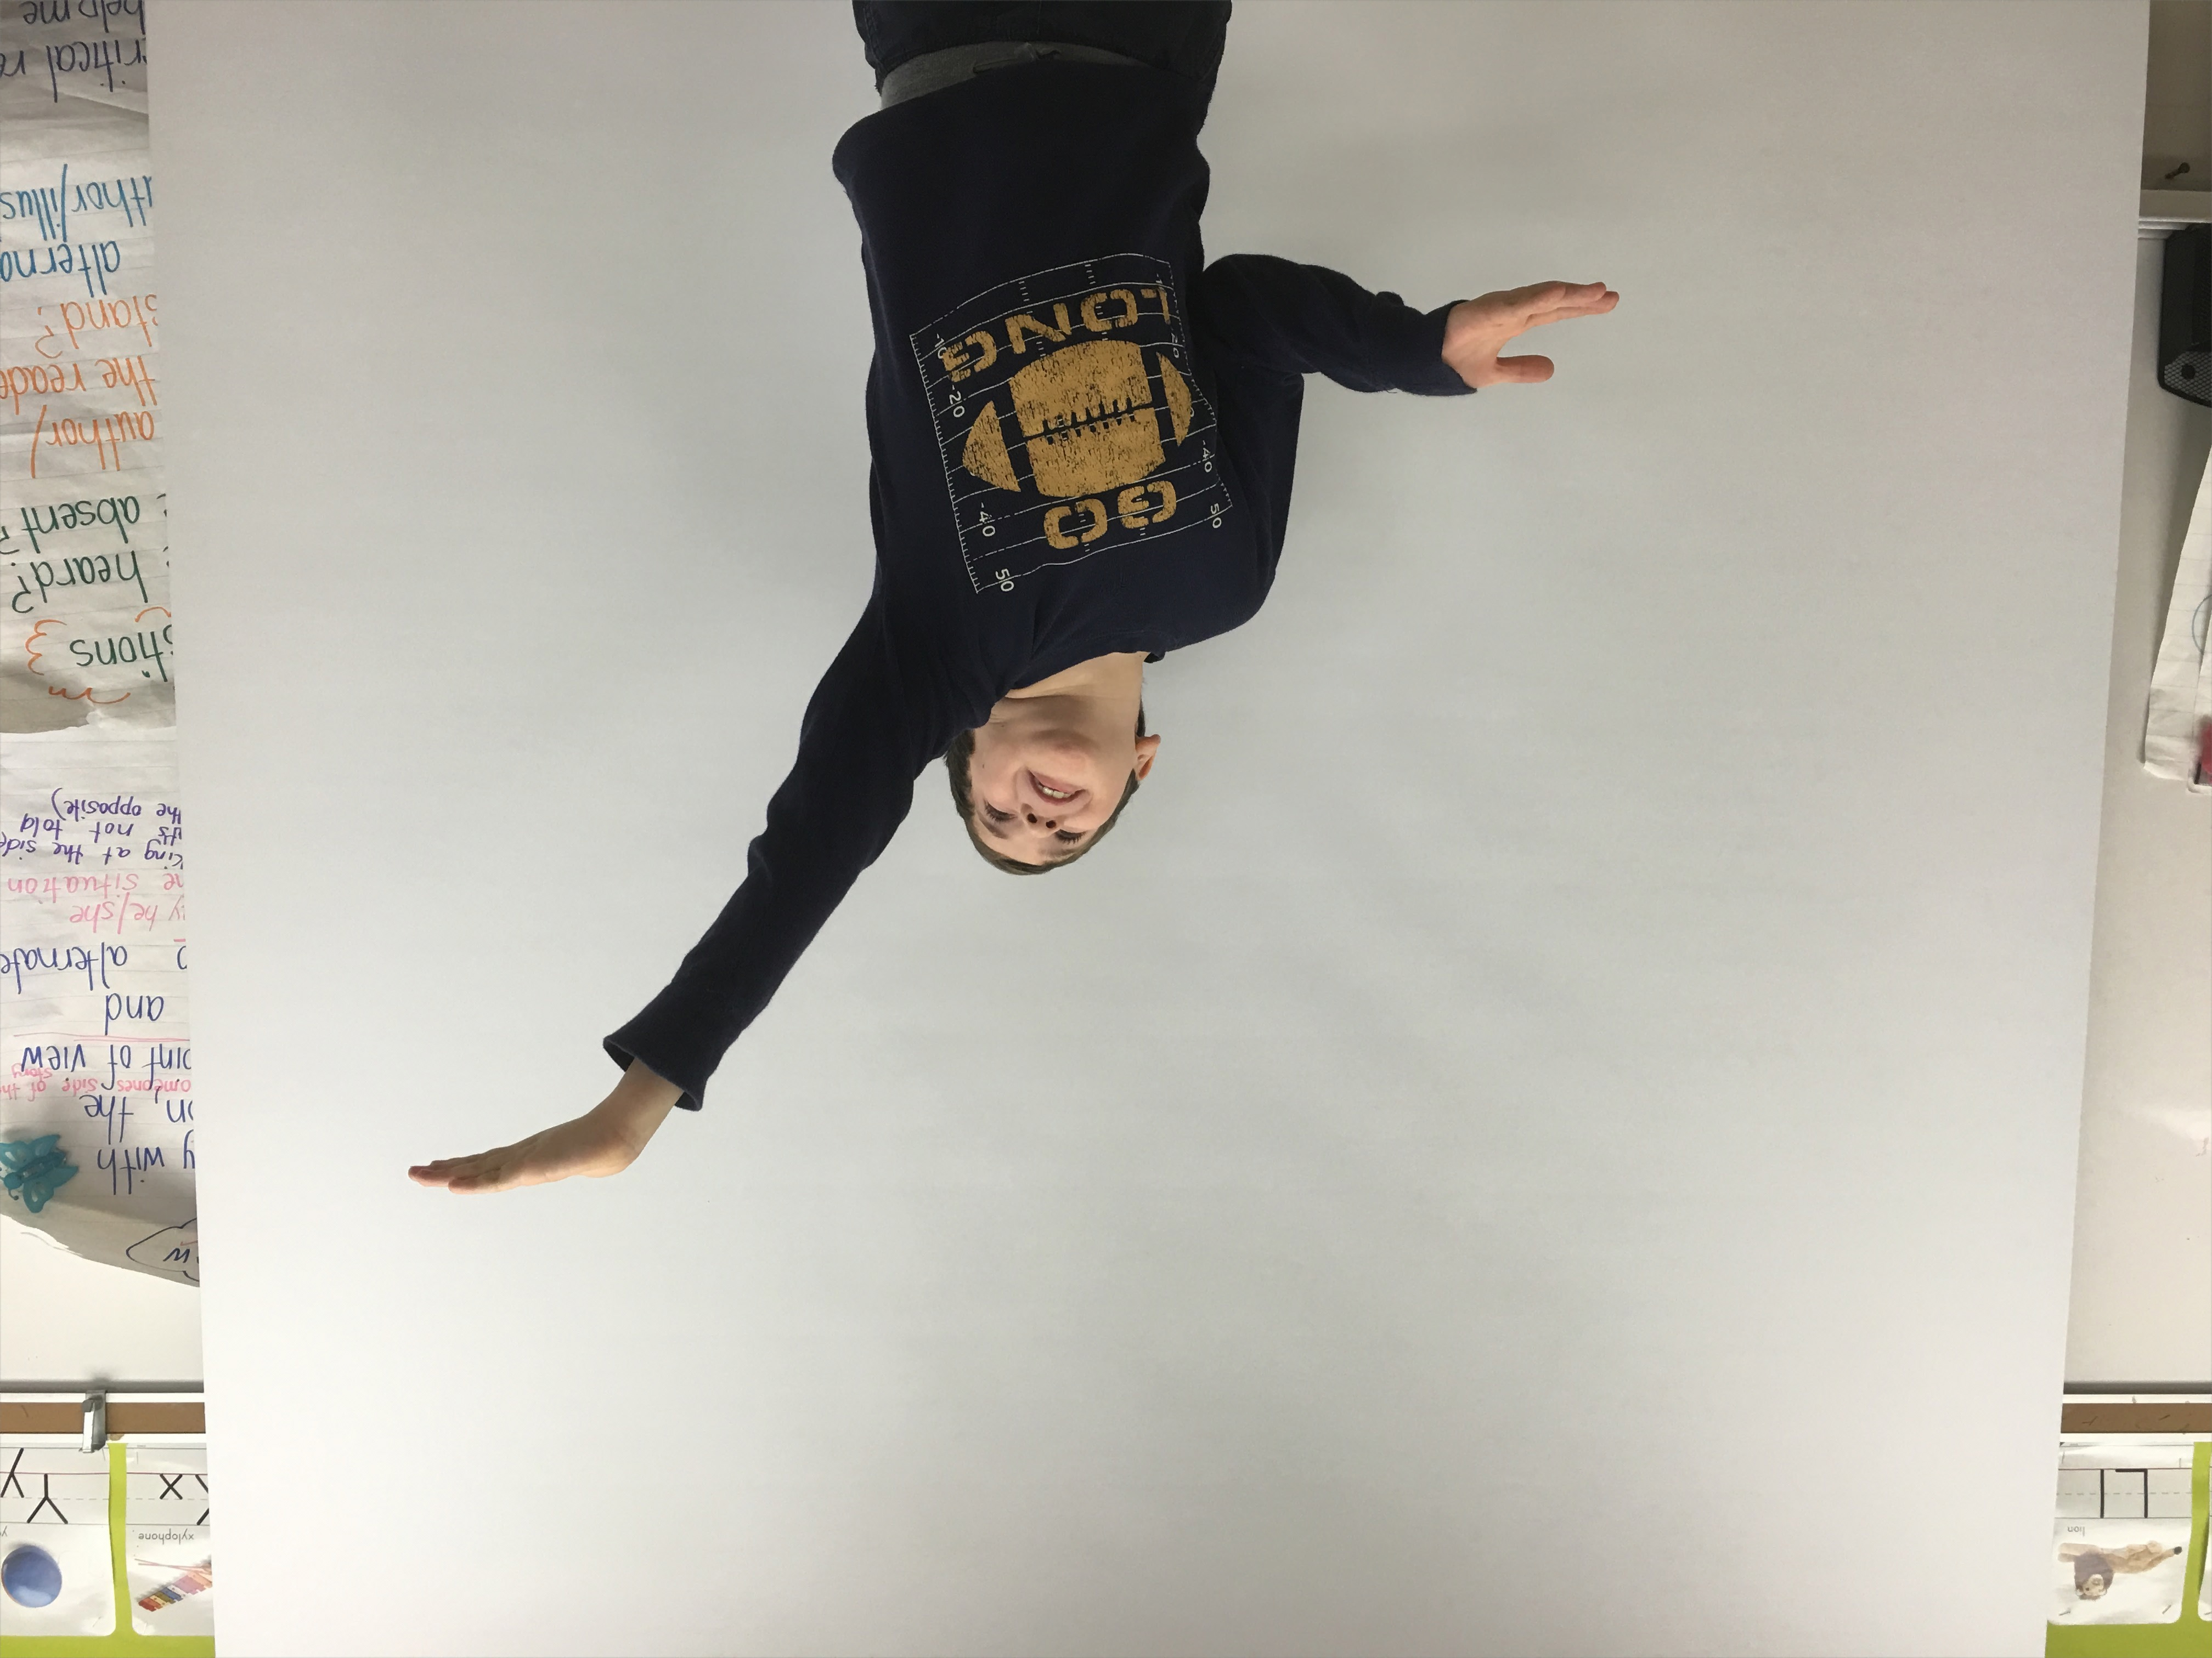
Tip
Pro
Pull your screen down as a backdrop!

Slide 14
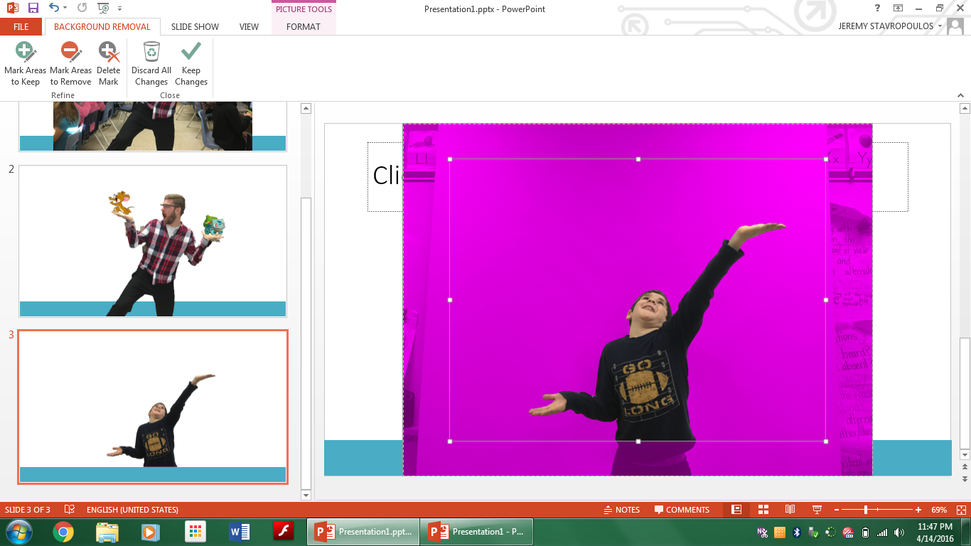

Slide 17
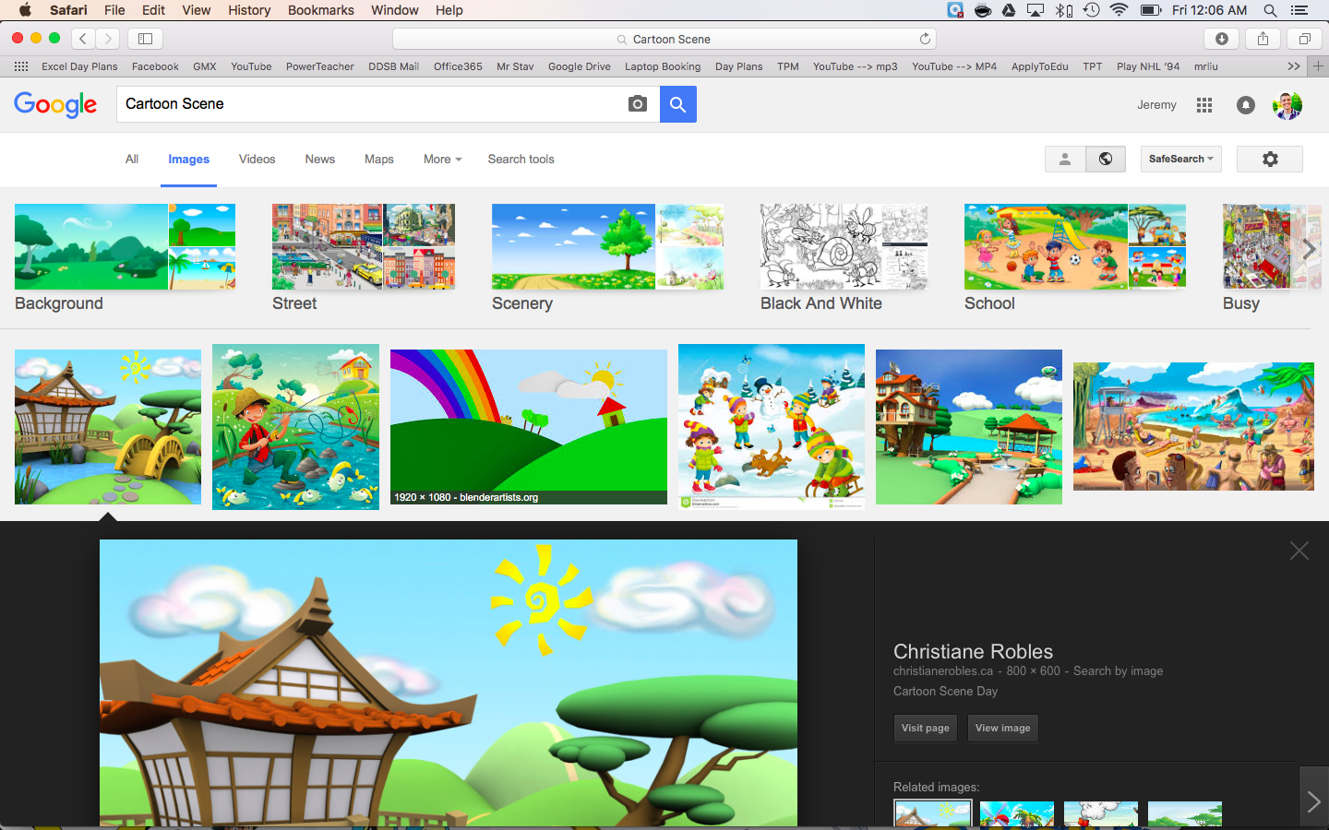

Slide 19
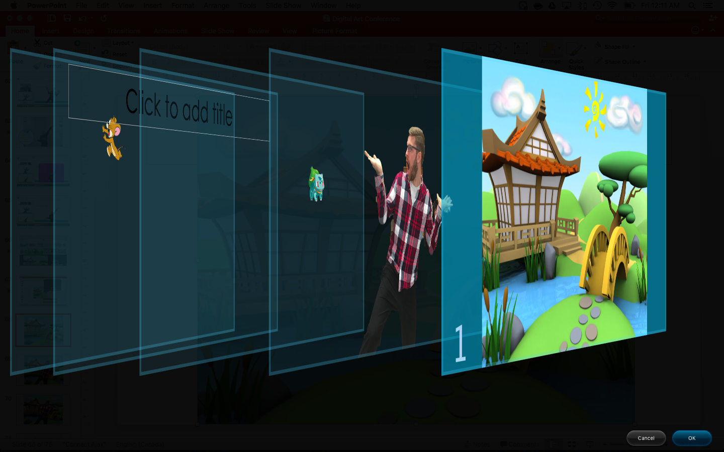

Slide 20
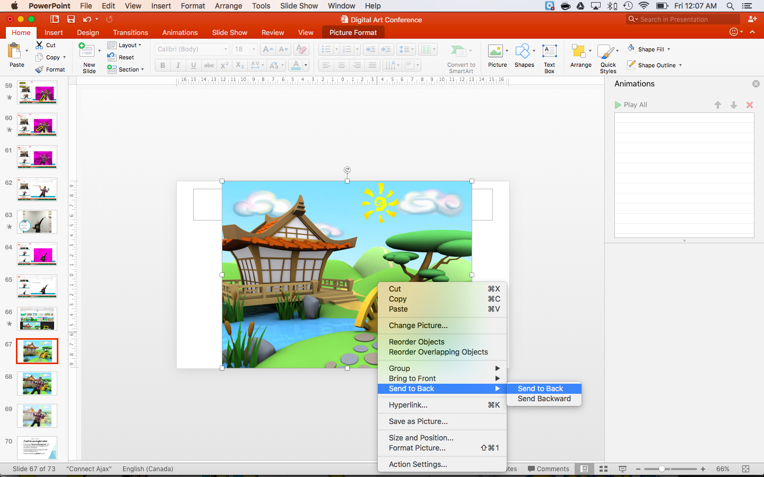

Slide 22
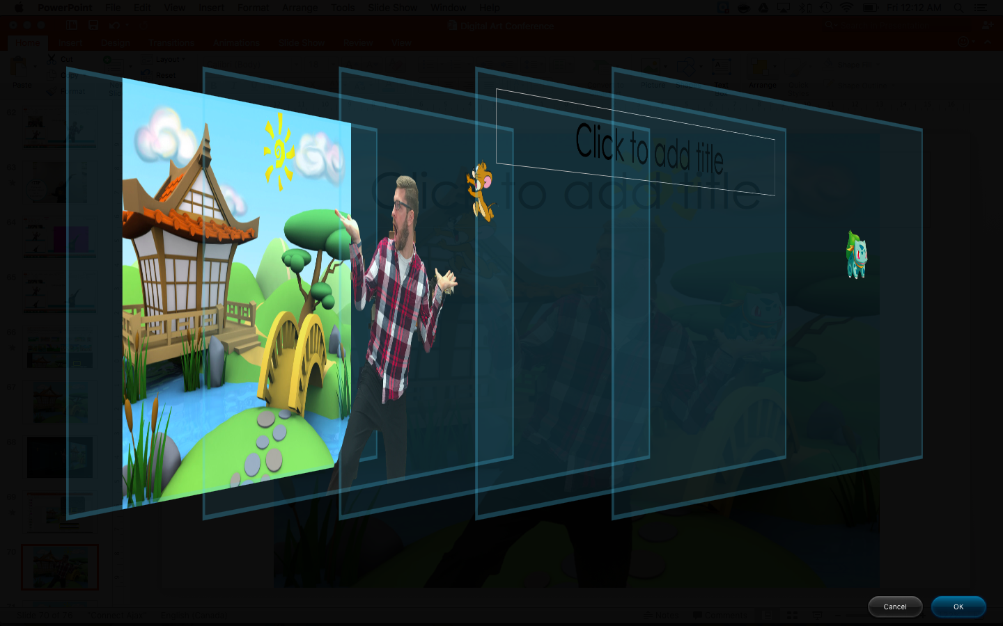

Slide 25
I will be successful when:
PNG Art
I have used ‘Removed Background’ tool to make the classroom background of my picture disappear
I have replaced my background with another digital picture
I have successfully printed my art

Slide 26
I will be successful when:
PNG Art
I have added my picture into my PowerPoint workspace
I have added 2 PNG image files to my picture
I have used ‘Removed Background’ tool to make the classroom background of my picture disappear
I have replaced my background with another digital picture
I have successfully printed my art

