Slide 3
An artistic work or practice that uses digital technology as an essential part of the creative or presentation process.
Digital Art

Slide 8
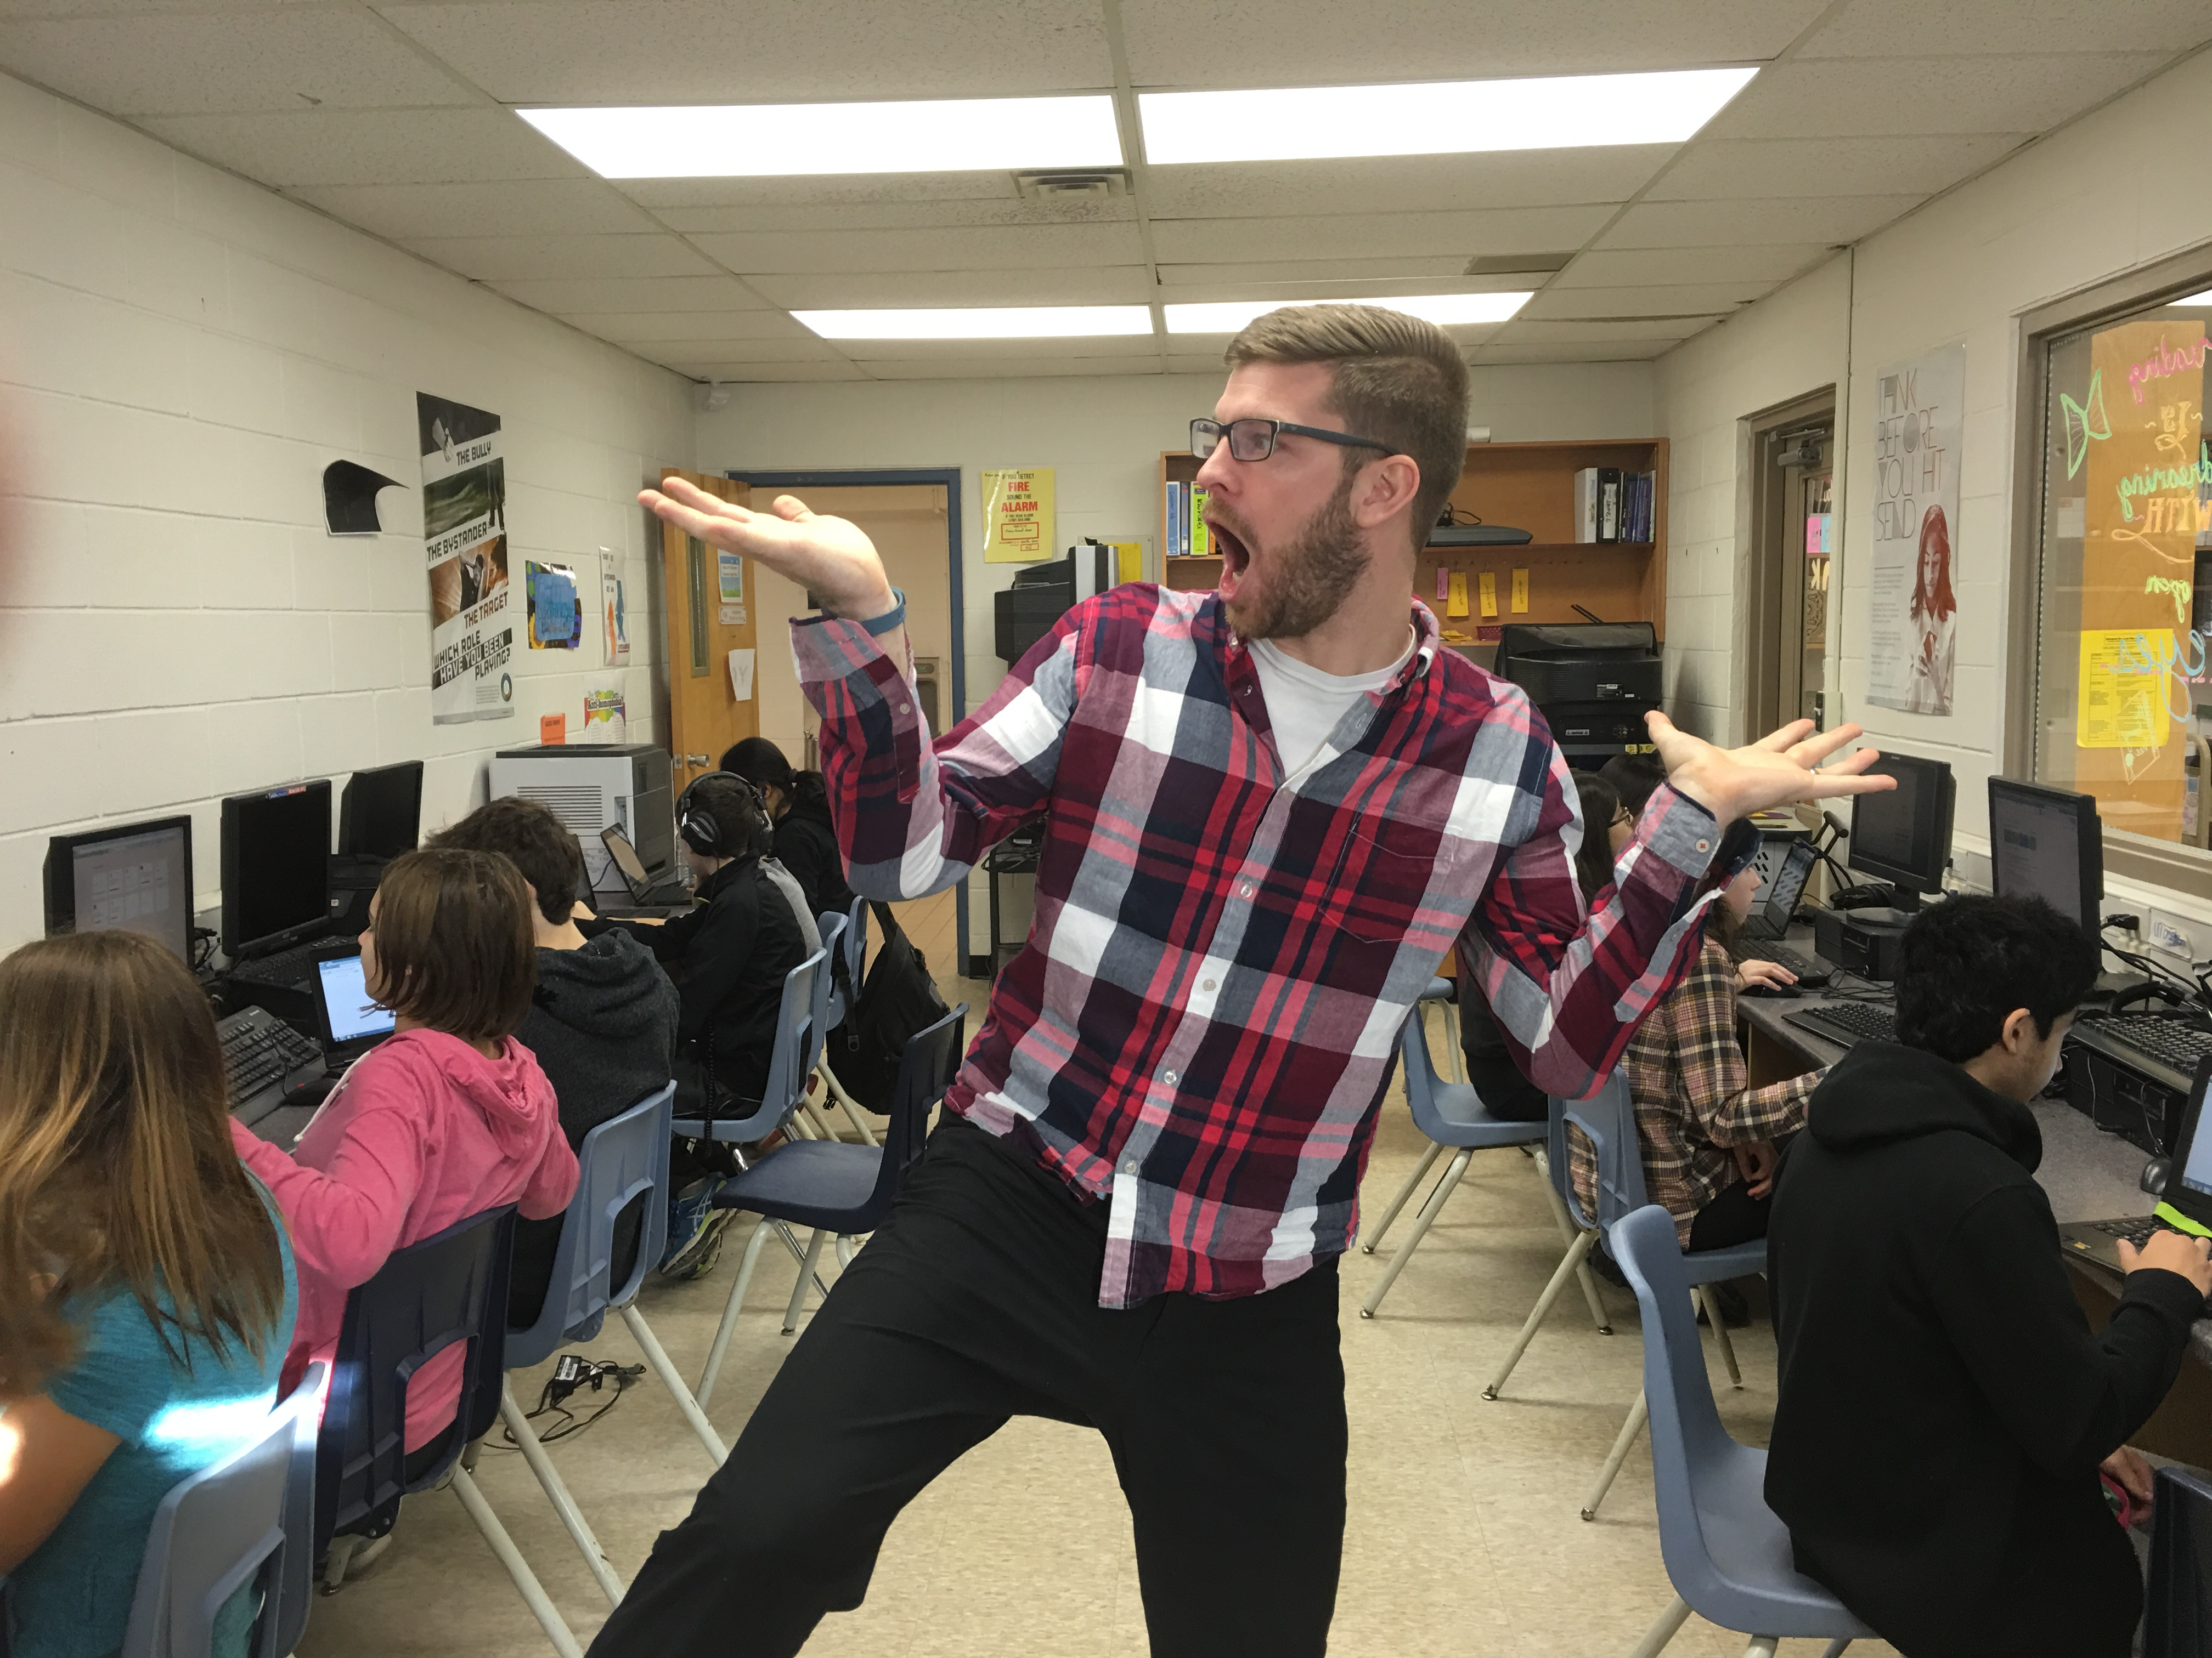

Slide 9
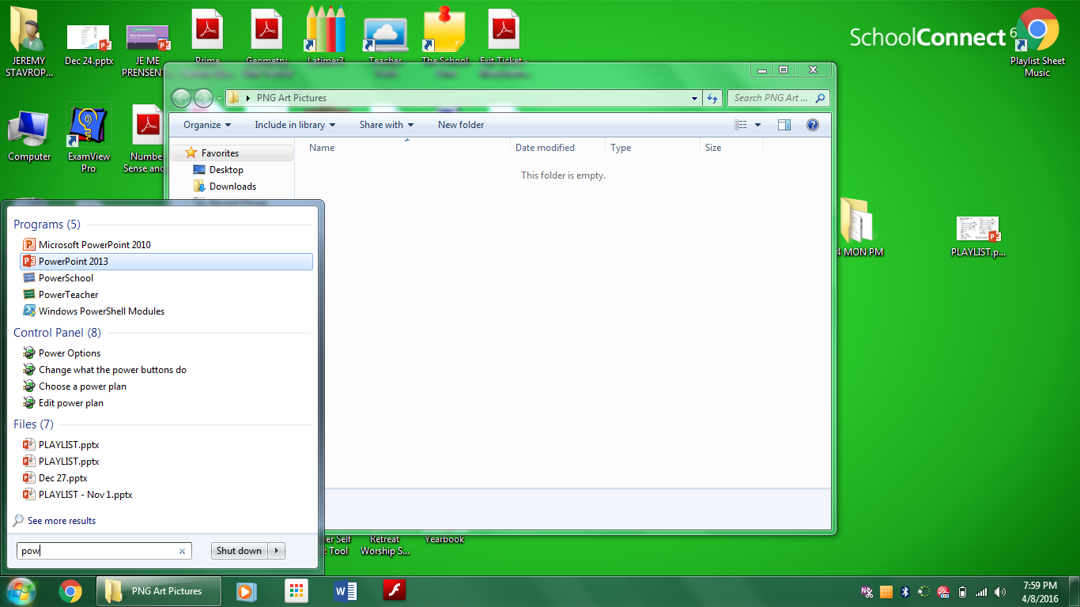
1: Open PowerPoint
Tip
Pro
To open PowerPoint,
type “POW” in the search

Slide 11
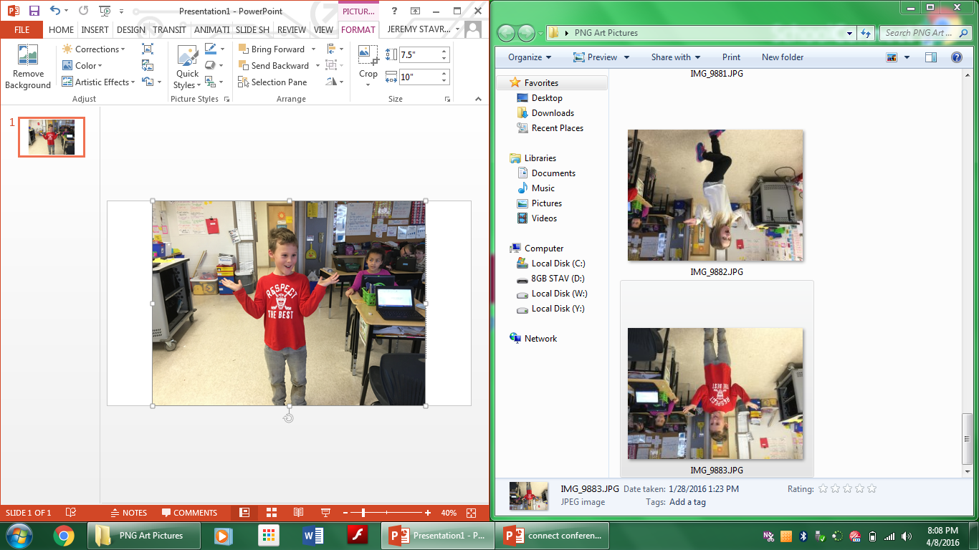

Slide 12
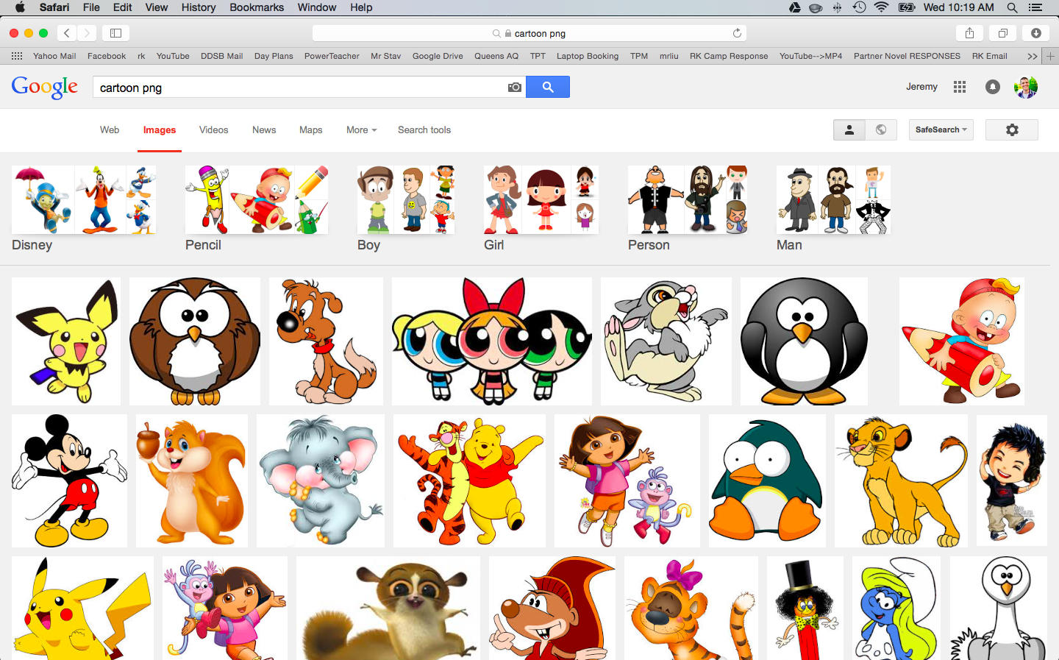

Slide 14
Tip
Pro
Drill these 3 letters into their memories!
They’re important!

Slide 15
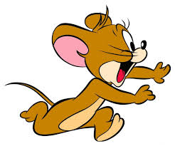

Slide 16
NOT A PNG
PNG

Slide 17
NOT A PNG
PNG

Slide 19
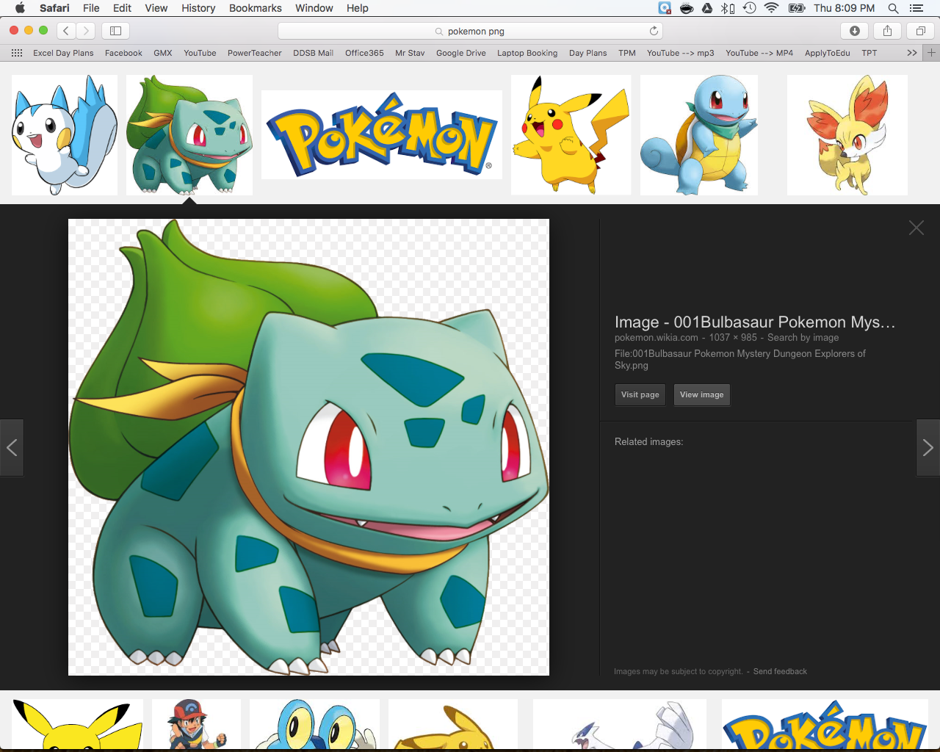

Slide 22
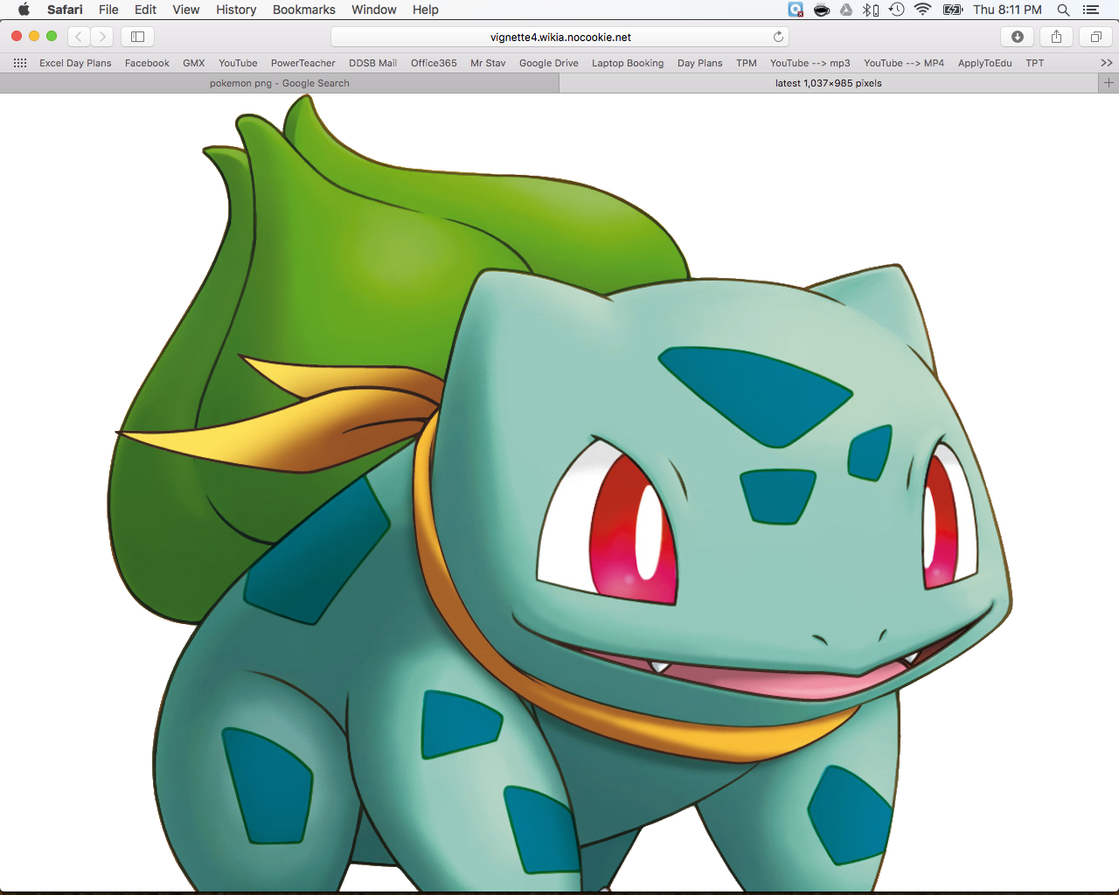

Slide 25
I will be successful when:
PNG Art
I have added my picture into my PowerPoint workspace
I have SAVED my PowerPoint to my “Home Folder U:”
I have added 2 PNG image files to my picture

Slide 26
END OF LESSON #1 LET THE STUDENTS EXPLORE
Tip
Pro
Set the lesson to loop on the screen while they work.
(3 second transition)

