Slide 1
EXCEL AS A MARKBOOK
CONNECT TECH CONFERENCE
12:35 - 1:20

Slide 2
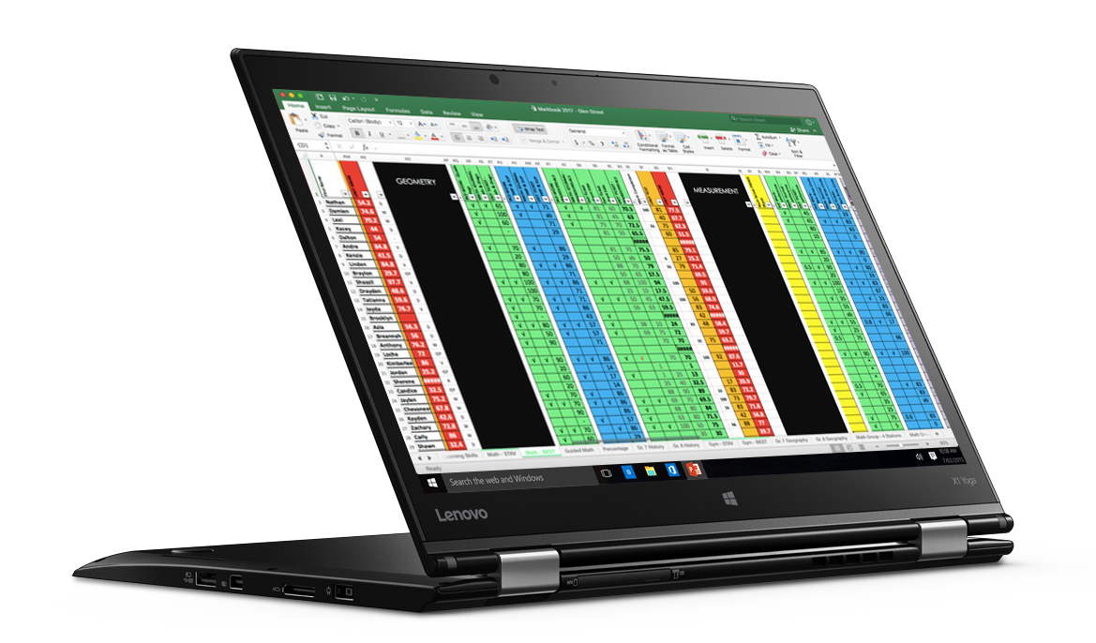

Slide 3
GRAB THE RESOURCE AT:
MrStav.ca/connect

Slide 4
MY RECOMMENDATION
During the session:
TRY the skills LIVE on a blank excel document to learn the concept
After the session:
Enjoy that the work has been done for you on the downloadable file at MrStav.ca/connect

Slide 5
In this session…
SLIDE #
^{SLIDE #} 7
Freeze Names column
Multiple subjects
Filters
to quickly sort your class lists by first names, last names, or even by assessment results
Automatic class averages
Automatic student averages
(This is helpful to show students what their mark COULD be if they "bump up" their work)
^{SLIDE #} 10
^{SLIDE #} 15
^{SLIDE #} 27
^{SLIDE #} 27

Slide 6
Bonus slides…
* = expert level skill
Add a column
Colour a column
Delete 1 or multiple columns
Change text direction
Clear Contents
*Weighted Average Formulas
*If/Then Formulas
^{SLIDE #} 39
^{SLIDE #} 41
^{SLIDE #} 43
^{SLIDE #} 45
^{SLIDE #} 47
^{SLIDE #} 50
^{SLIDE #} 54

Slide 7
FREEZE

Slide 8
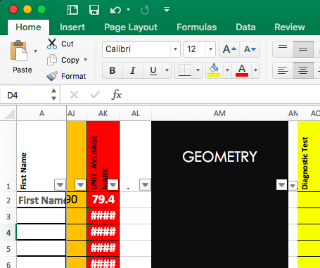
how to…
FREEZE FIRST COLUMN

Slide 9
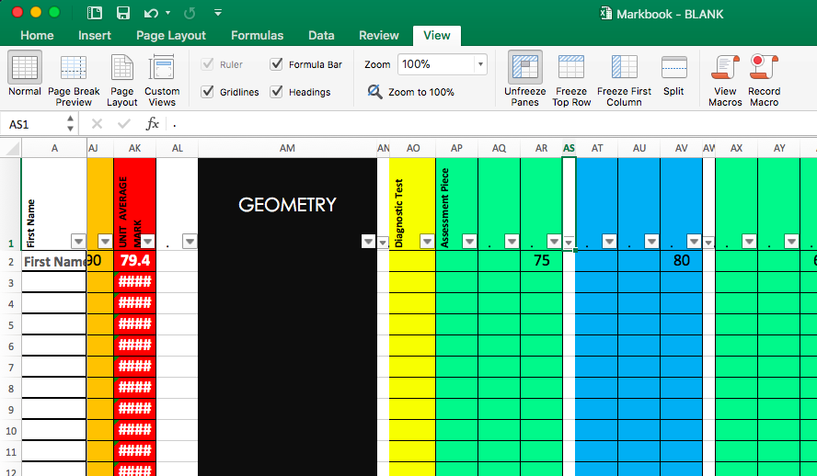

Slide 10
SUBJECTS

Slide 11
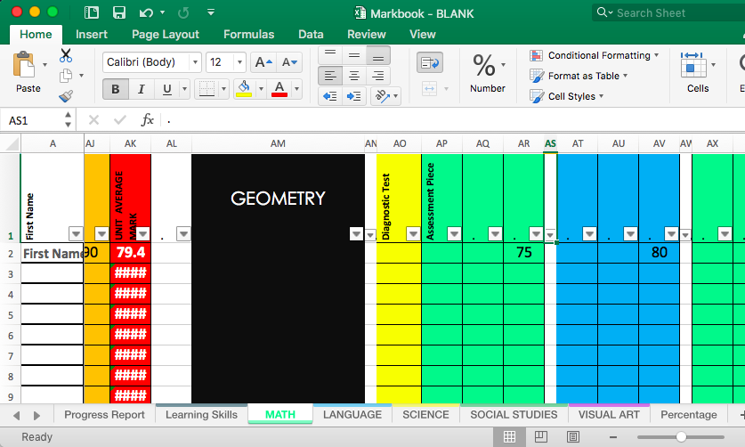
how to…
MULTIPLE
SUBJECTS
Excel term: “worksheets”

Slide 12
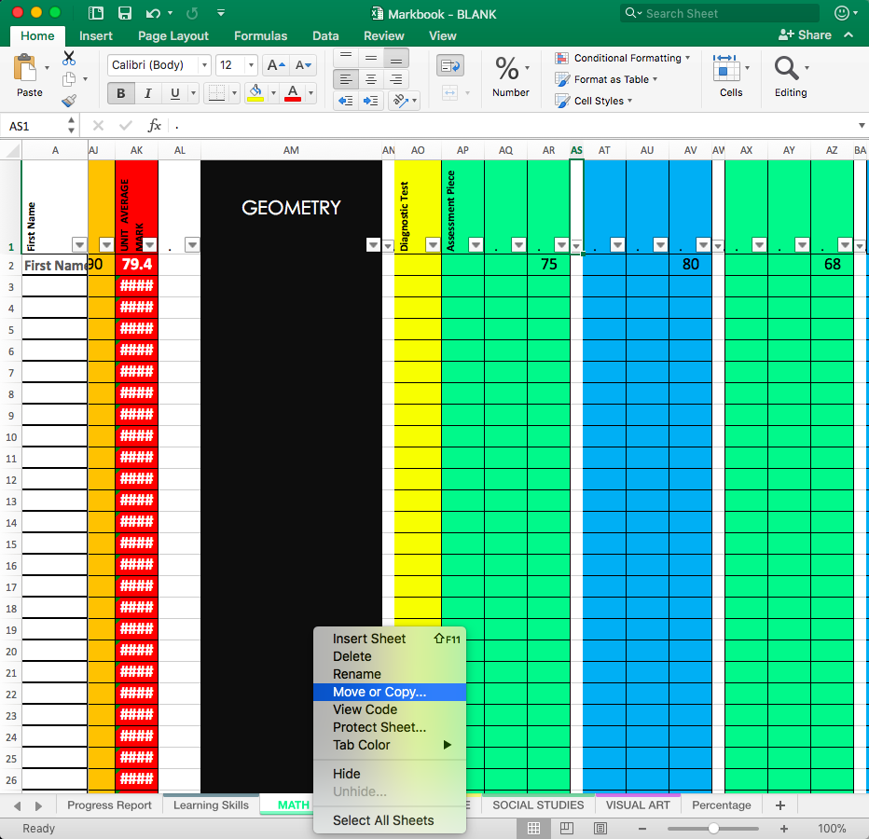

Slide 13
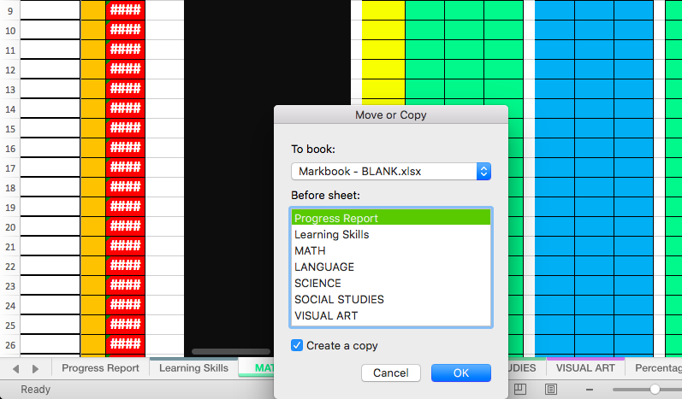

Slide 14
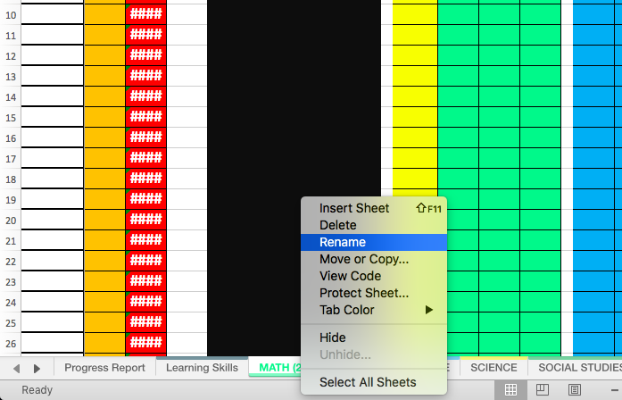

Slide 15
FILTER

Slide 16
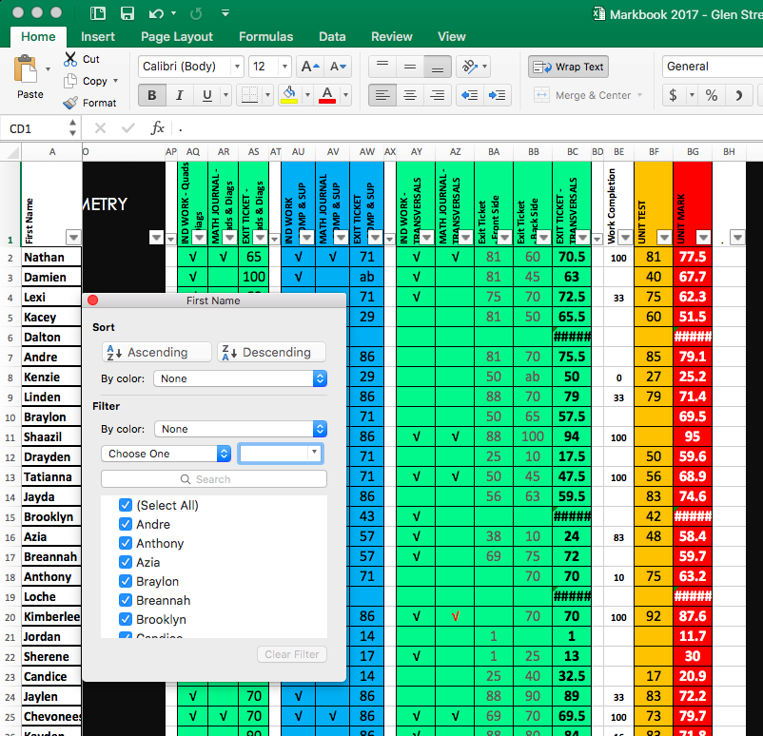
what is…
FILTER?

Slide 17
what is…
FILTER?

Slide 18
why
FILTER?
Sort by first name
Everyday
Sort by last name
Report Cards
Sort by marks/ levels
Levelled grouping
Isolate only 1 student
Privacy during conferencing

Slide 19
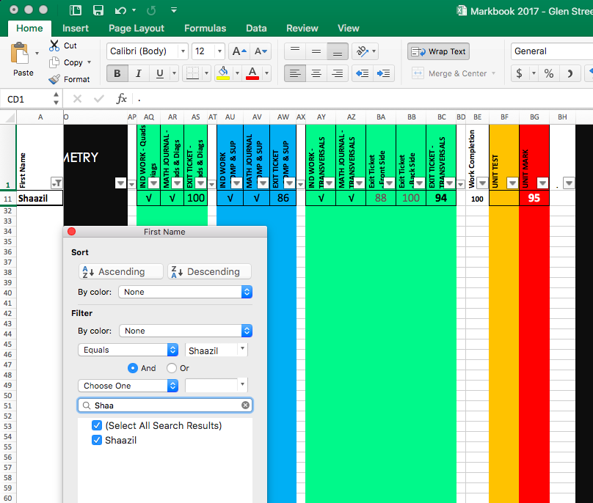
isolate
for privacy
No other students’ marks can be seen

Slide 20
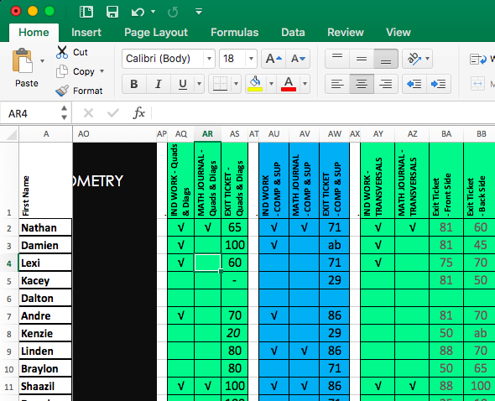
how to…
FILTER
Click on any cell
Row 2 or lower

Slide 21
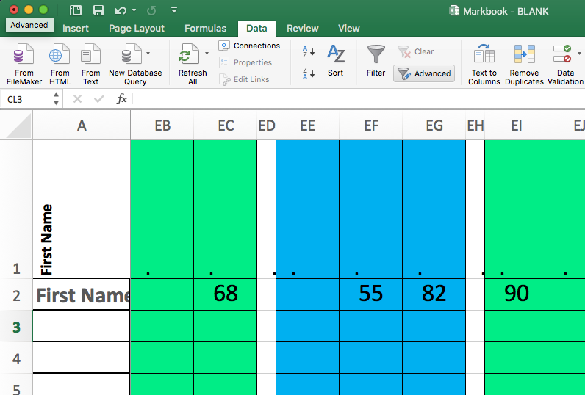

Slide 22
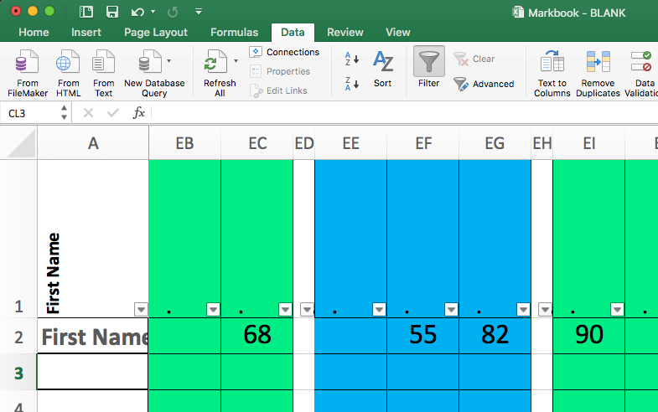

Slide 23
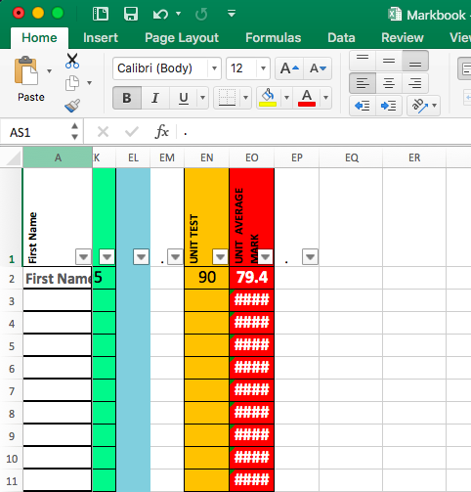
It will only filter from LEFT to RIGHT
It will STOP when it gets to an empty cell
WARNING!

Slide 24
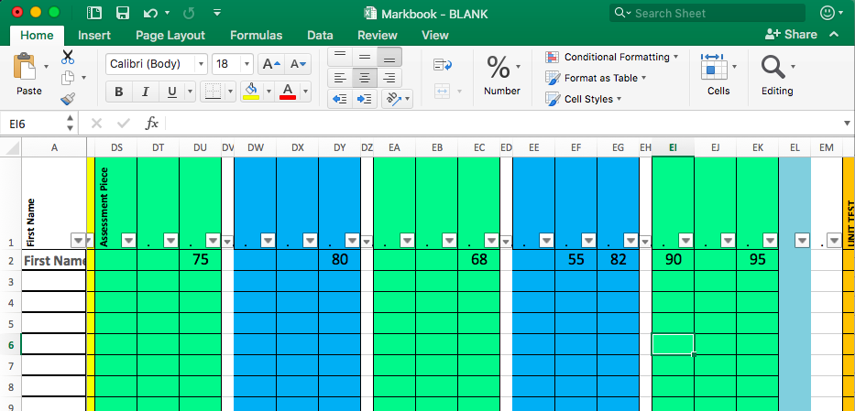
MY SOLUTION: put a period in each cell of Row 1 as a placeholder
WARNING!

Slide 25
why
FILTER?
Sort by first name
Everyday
Sort by last name
Report Cards
Sort by marks/ levels
Levelled grouping
Isolate only 1 student
Privacy during conferencing

Slide 26
isolate
for privacy
No other students’ marks can be seen

Slide 27
AVERAGES

Slide 28
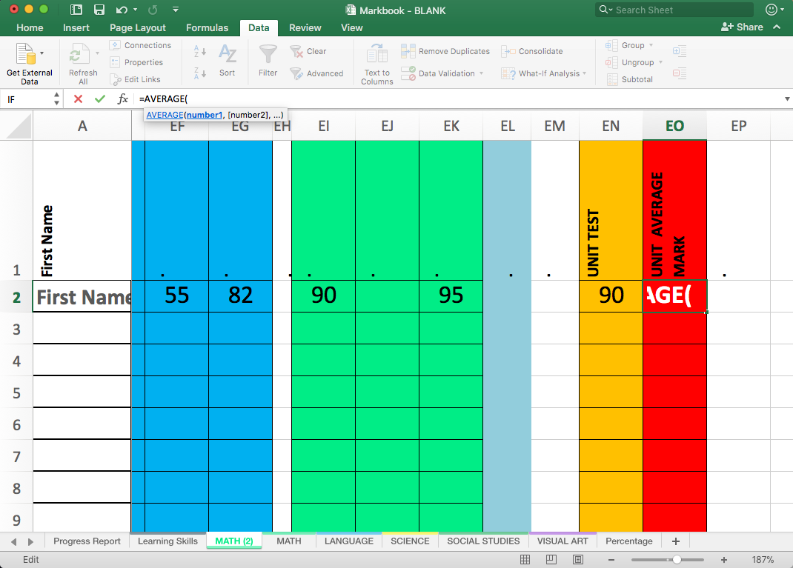
TYPE INTO FORMULA BOX
=AVERAGE(

Slide 29
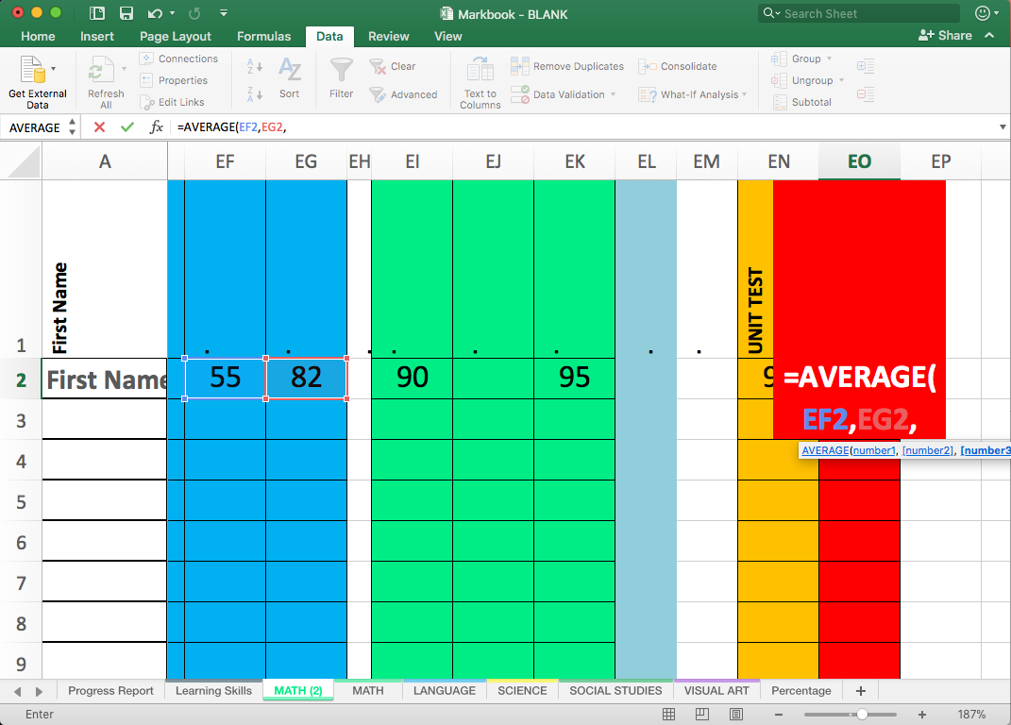
TYPE INTO FORMULA BOX
=AVERAGE(
HOLD CTRL AND CLICK THE MARKS YOU WANT TO AVERAGE

Slide 30
These coloured borders will tell you what you have selected.

Slide 31
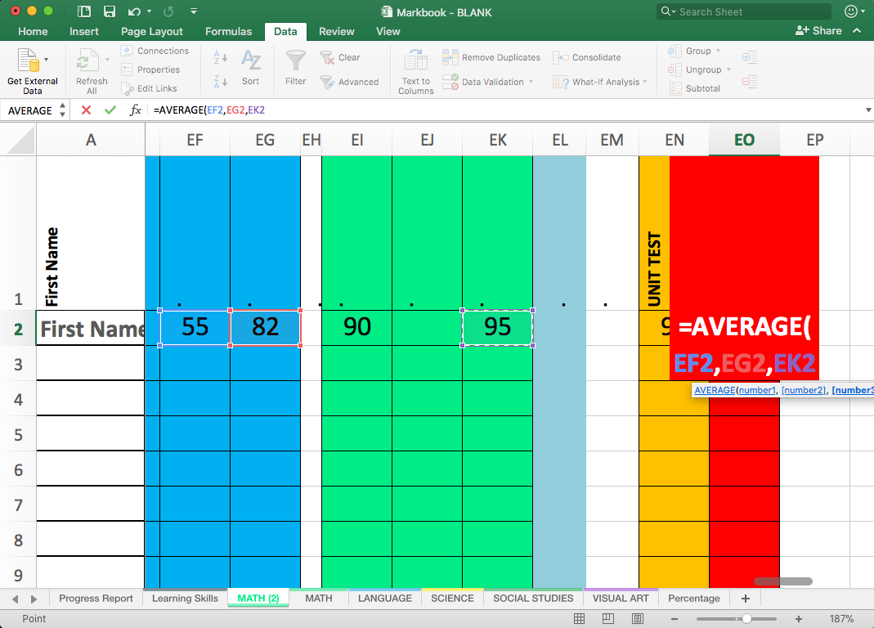

Slide 32
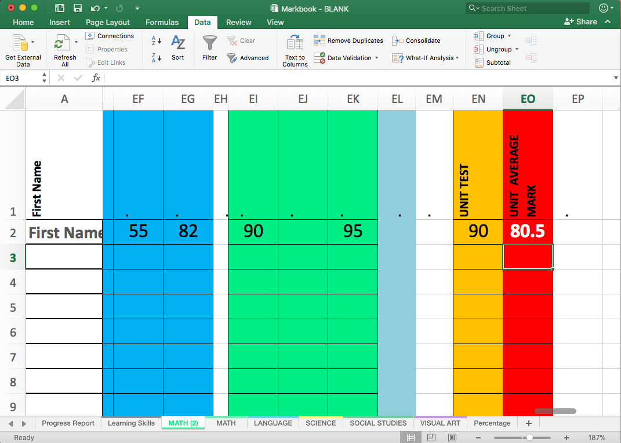
IT WILL NOW AUTOMATICALLY CHANGE THE MARK IF YOUR DATA CHANGES
TIP: let students see the impact “Bumping Up” their work can have on their mark.

Slide 33
NOW YOU CAN APPLY THAT FORMULA TO ALL THE STUDENTS IN JUST ONE CLICK.

Slide 34
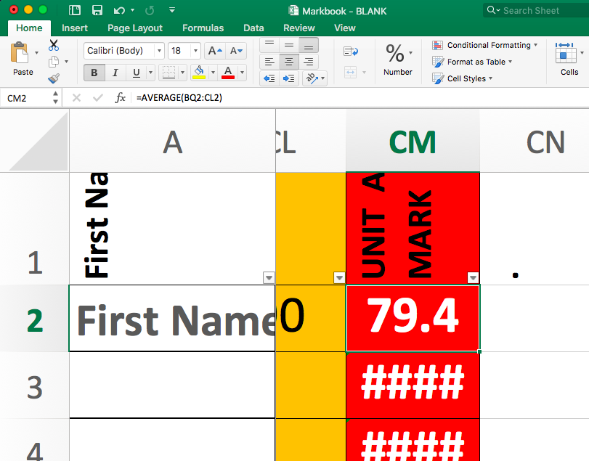

Slide 35
REGULAR EXCEL MOUSE
CLICK + HOLD
DRAG
AUTO FILL MOUSE

Slide 36
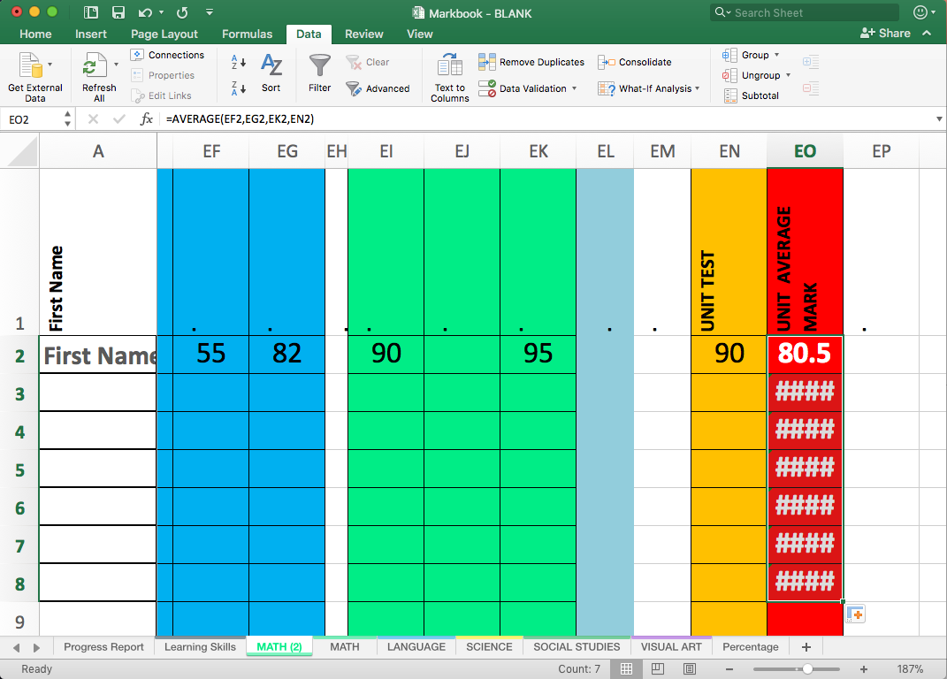

Slide 37
`
“####” is a placeholder as there is not data for it to average

Slide 38
why
AVERAGE?
Teacher
Makes report cards instant
Students
Students can see their mark
Students can see how their mark would change

Slide 39
ADD A COLUMN

Slide 40
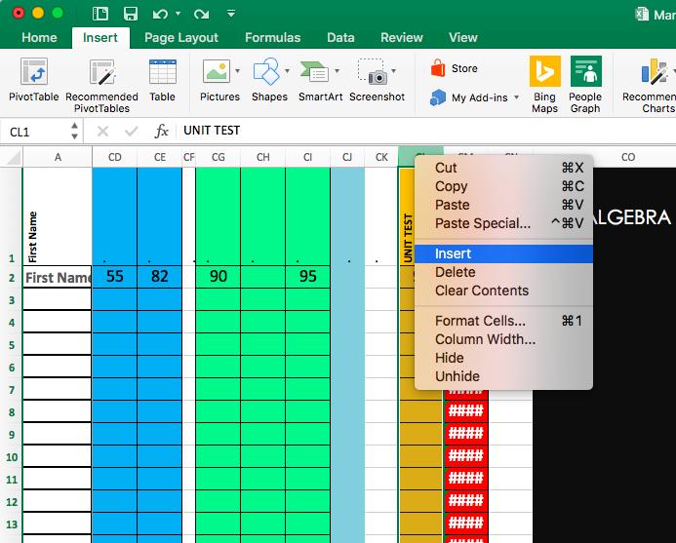

Slide 41
COLOUR A COLUMN

Slide 42
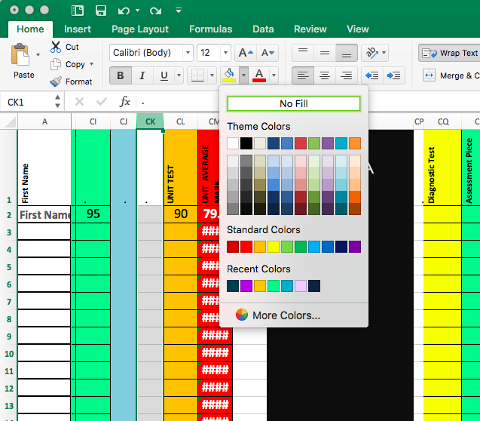

Slide 43
DELETE ONE OR MULTIPLE COLUMNS

Slide 44
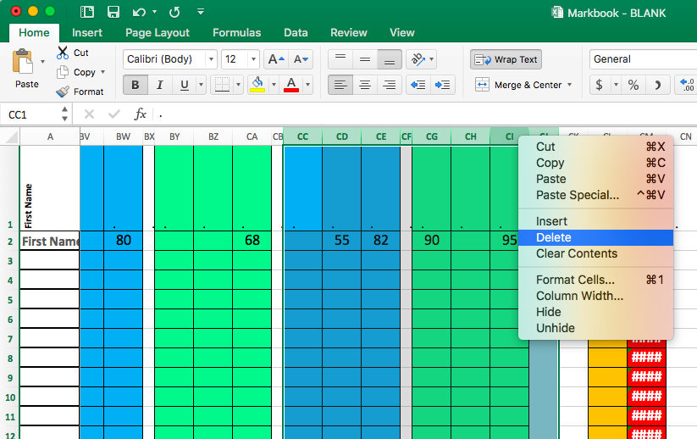

Slide 45
CHANGE TEXT DIRECTION

Slide 46
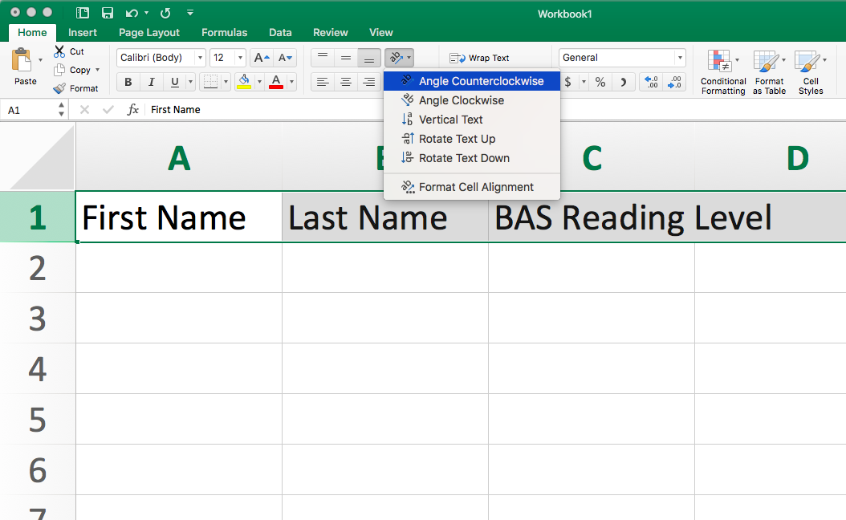

Slide 47
CLEAR CONTENTS

Slide 48
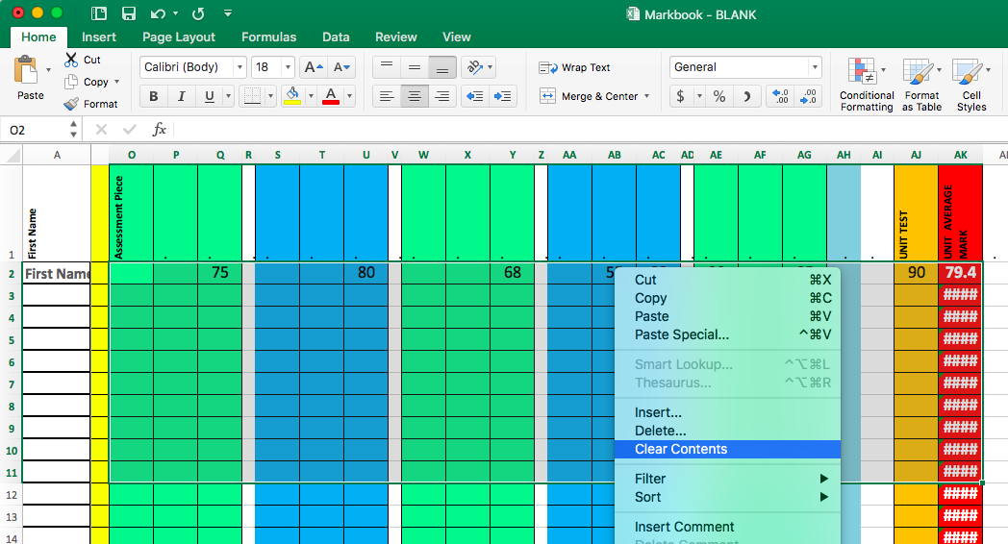

Slide 49
SCARY
ADVANCED
FORMULAS
AKA: THE NOT-SO BASIC

Slide 50
SCARY
WEIGHTED AVERAGE
FORMULAS

Slide 51
“WEIGHTED AVERAGE” FORMULAS
You can write a scary looking formula to have excel make one mark worth more than another.
FOR EXAMPLE:
Exit tickets worth – 5% of the mark
Unit Tests worth – 30% of the mark

Slide 52
“WEIGHTED AVERAGE” FORMULAS
Here is the formula...
=SUM(H6*1+L6*0.5+S6*4+X6*1+AC6*2+AH6*1.5)
These change based on what cell your marks are in

Slide 53
“WEIGHTED AVERAGE” FORMULAS
Here is the formula explained as a Phys-Ed example...
=SUM(H6*1+L6*0.5+S6*4+X6*1+AC6*2+AH6*1.5)
15% - FITNESS:
20% - MOVE STRATEGY:
10% - LIVING SKILL:
10% - MOVE SKILL:
40% - PARTICIPATION:
5% - SAFETY:

Slide 54
SCARY
“IF / THEN”
FORMULAS

Slide 55
“IF / THEN” FORMULAS
You can write a scary looking formula to have excel interpret a percentage mark into a letter grade

Slide 56
“IF / THEN” FORMULAS
Here is the formula...
=IF(AJ2>89.9,"A+",IF(AJ2>84.9,"A",IF(AJ2>79.9,"A-",IF(AJ2>76.9,"B+",IF(AJ2>72.9,"B",IF(AJ2>69.9,"B-",IF(AJ2>66.9,"C+",IF(AJ2>62.9,"C",IF(AJ2>59.9,"C-",IF(AJ2>56.9,"D+",IF(AJ2>52.9,"D",IF(AJ2>49.9,"D-"))))))))))))

Slide 57
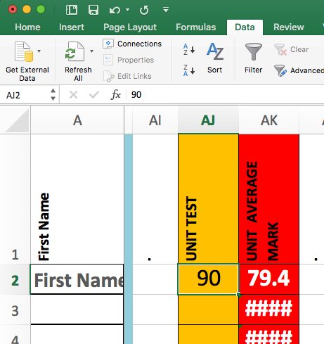
“IF / THEN” FORMULAS
Here is the formula...
=IF(AJ2>89.9,"A+",IF(AJ2>84.9,"A",IF(AJ2>79.9,"A-",IF(AJ2>76.9,"B+",IF(AJ2>72.9,"B",IF(AJ2>69.9,"B-",IF(AJ2>66.9,"C+",IF(AJ2>62.9,"C",IF(AJ2>59.9,"C-",IF(AJ2>56.9,"D+",IF(AJ2>52.9,"D",IF(AJ2>49.9,"D-"))))))))))))

